Slide 1
What is Pop Culture Tourism?
Module 1

Slide 2
MODULE 1 CONTENTS
WHAT IS POP CULTURE TOURISM?
1
FILM AND TV INSPIRED TOURISM
2
MUSIC TOURISM
3
LITERARY TOURISM
4
5
COSPLAY, VIDEO GAMES and more…
This project has been funded with support from the European Commission. This publication reflects the views only of the author(s), and the Commission cannot be held responsible for any use, which may be made of the information contained therein.

Slide 3
SECTION 1
WHAT IS POP CULTURE TOURISM?

Slide 4
WHAT IS POP CULTURE TOURISM?
Pop Culture tourism is travel motivated by pop culture phenomena such as books, films and music. For example, Pop Culture Tourists who love Harry Potter flock to London’s King's Cross Train Station to pose at a trolley that's halfway disappeared into a wall at the fictional Platform 9 and ¾..

Slide 5
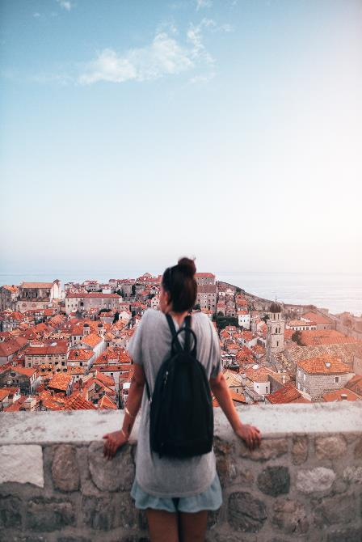
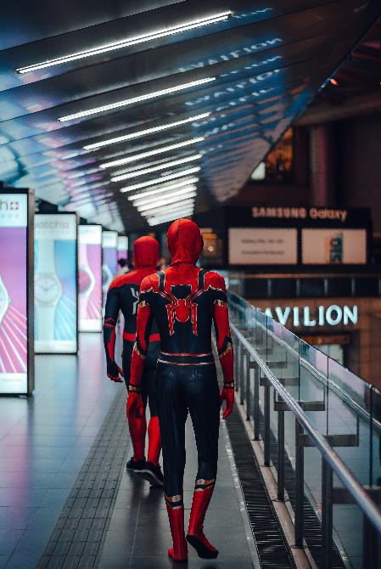
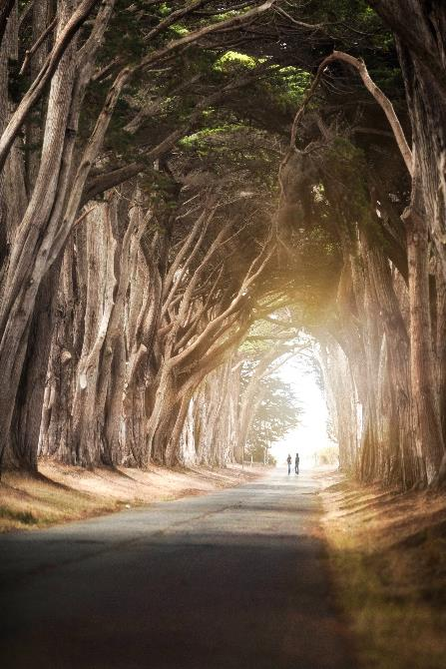
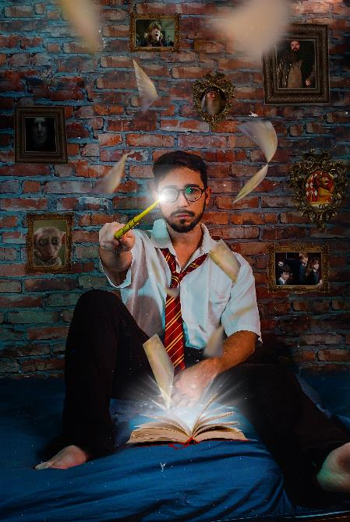
POP CULTURE TOURISM OPPORTUNITIES
You can explore and use Pop Culture to..
Attract new customers to your destination
Consolidate your existing tourism services
Create new tourism products or services
Create a spin off or new pop culture tourism business
MARKETING
INNOVATION
PRODUCT DEVELOPMENT
BUSINESS DEVELOPMENT

Slide 6
WHY SHOULD YOU CONSIDER INNOVATING YOUR TOURISM BUSINESS THROUGH POP CULTURE?
Pop culture tourism is a subset of cultural tourism which accounts for almost half of all international tourism trips according to the United Nations World Tourism Organization. In the UK, over 2 million pop culture tourists visit annually, and they spend a whopping £1750 million!!
Pop culture tourism is the gift that keeps on giving… Did you know that almost 70 years later tourists still flock to the quiet village of Cong in Mayo where The Quiet Man was filmed?
In many respects, pop culture tourism offers a ready-made customer base of fans/fanatics who are brand loyal and in search of authentic, immersive experiences that can bring them closer to the shows, characters, celebrities and places that they have come to love..

Slide 7
POP CULTURE PRODUCTION/CONSUMPTION
Taking a look at movie and tv production/consumption, it is easy to see how the digitilisation of the modern world has impacted the growth of online TV streaming. Now in the UK (and most of the rest of Europe) online TV and on demand streaming is far outpacing traditional cable.
Why? Being able to watch any of the movies, TV Shows, documentaries, news, and live events you like and watch them when you want on any smart device of choice is the best and only way to consume media. In the past, there was little choice in what you watched. You had limited terrestrial channels and limited choice. But now technology has made choice more accessible. On demand services allow you to watch your favourite tv show box set 10 times over if you want!
Netflix spends circa $17 billion on content production each year!

Slide 8
+ pop culture production/consumption
+ digitalization, internet use and social media
+ cheap flights and travel
+ fomo (fear of missing out)
EXPONENTIAL GROWTH OF POP CULTURE TOURISM
RECENT GROWTH OF POP CULTURE TOURISM

Slide 9
THE GAME OF THRONES EFFECT
This Photo is licensed under CC BY-SA
Games of Thrones has really brought pop culture tourism into focus in Europe and its ability to transform the tourism economies of its film locations which have now become pop culture tourism destinations. The show was primarily filmed in Northern Ireland, Croatia, Iceland and Spain.

Slide 10
Game of Thrones (if you don’t already know) is the immensely popular television show that has aired for four seasons on HBO. The show is based on the epic fantasy novel series, A Song of Fire and Ice, written by George R. R. Martin.
The series premiered in the United States in April 2011 and concluded in May 2019. It is said to have 30 million devotees in the US and many millions across the globe.
It has had a profound effect on tourism in Croatia, Northern Ireland and Iceland.
This Photo is licensed under CC BY-SA-NC
This Photo is licensed under CC BY-SA-NC

Slide 11
Game of Thrones is reportedly responsible for a 10% annual growth in tourism in Dubrovnik (Croatia) aka Kings Landing and half of all tours offered in the city are now related to Game of Thrones.

Slide 12
“
When I started with GoT tours back in 2013. it was not that popular, but after season 4 it boomed.
”
Ivan Vuković Vuka
Tours Guide
Croatia
Source

Slide 13
The show has also created a tourism boom for Northern Ireland, which hosts most of the filming, drawing tens of thousands of fans to sets and locations and £30m in spending each year, according to Tourism Ireland.

Slide 14
“
For us, Game of Thrones has been that big game changer we always hoped we’d get.
”
Caroline McComb
Game of Thrones Coach Tours
Northern Ireland

Slide 15
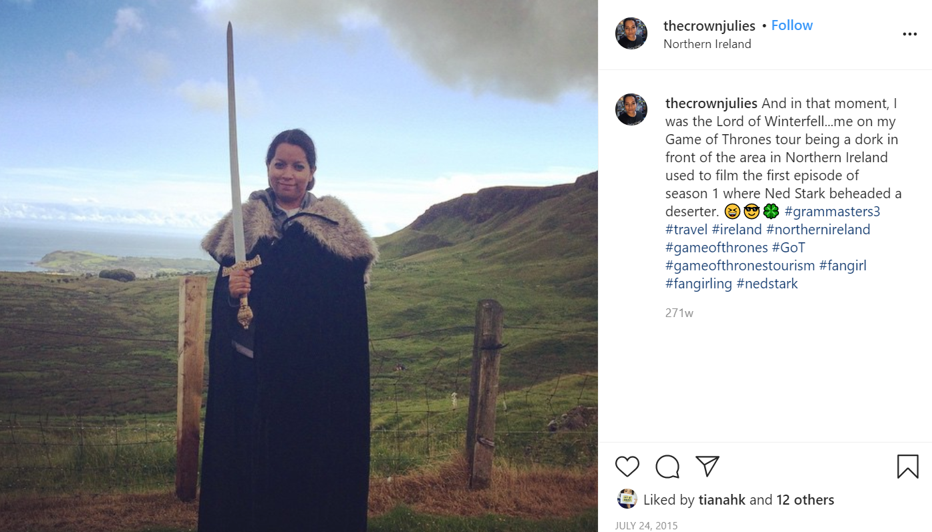
Pop culture tourism experiences like this make for instagrammable pic and user generated marketing!

Slide 16
Visitor numbers in Iceland grew from just 500,000 in 2010 to around 2.2m in 2018 – an increase of 340 per cent. Iceland now has around seven times more annual tourists than residents.

Slide 17
“
We were a tiny company when the show first came here – it has lifted us to new heights. Now around half of the tours we run are themed around the show.
”
Jon Thor Benediktsson
The Travelling Viking Tour Guide
Iceland
Source

Slide 18
SECTION 2
FILM AND TV INSPIRED TOURISM

Slide 19
FILM AND TV INSPIRED TOURISM
This form of tourism describes visits (whether they be holidays, weekends or day trips) made to explore places associated with films and television programmes. This might involve visits to film locations and film studios/sets. It also includes sites associated with film and TV celebrities. Let’s take at look at some examples..

Slide 20
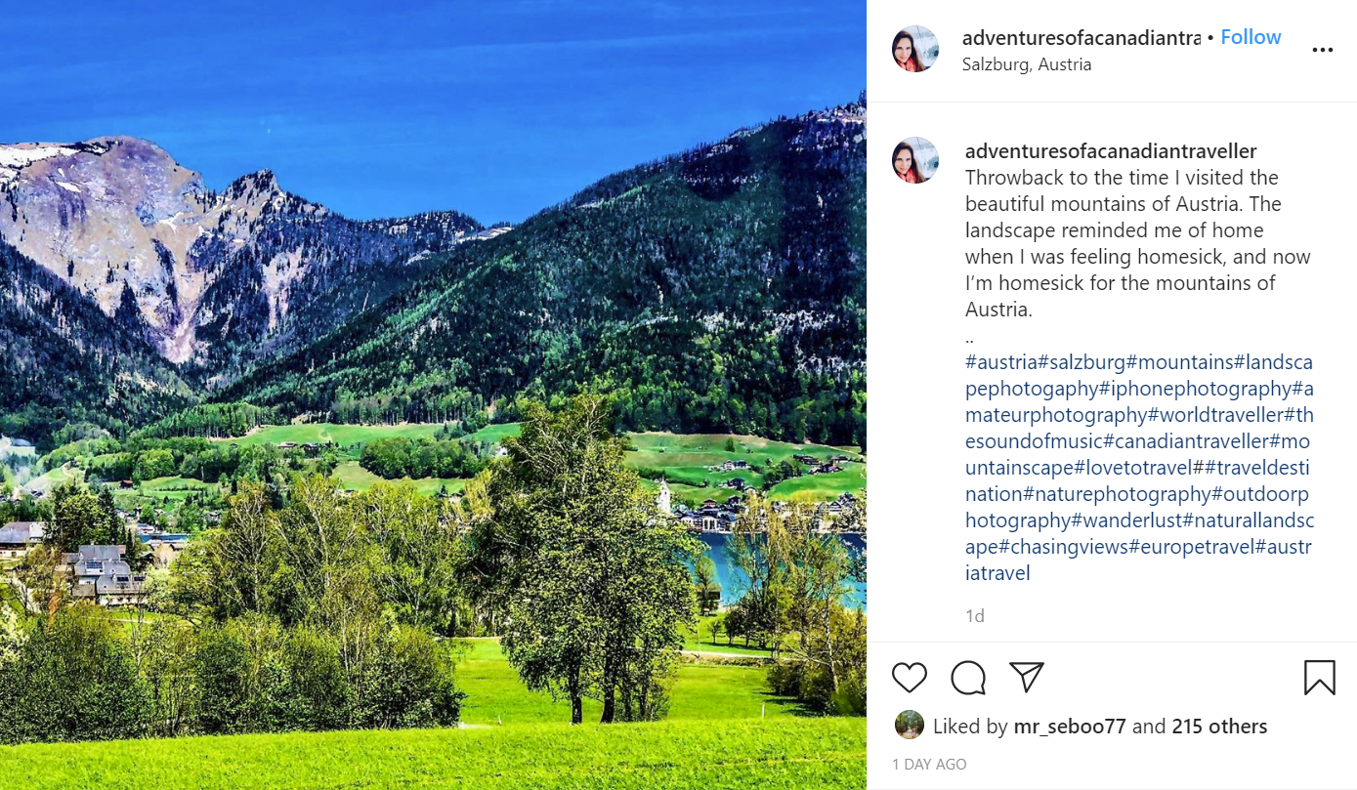
The Austrian Alps are a must for Sound of Music lovers!

Slide 21
This video explore the Irish connection to Star Wars and visit Skellig Michael off the Kerry coast - the real life planet Ahch-To from The Last Jedi and The Force Awakens.

Slide 22
“
From Glenfinnan Viaduct in Scotland where the Hogwarts Express travelled, to Professor McGonagall’s classroom at Durham Cathedral, to exploring the Forbidden Forest at Warner Bros Studio, Harry Potter’s Britain is the stuff of magic.
”
Patricia Yates, Visit Britain

Slide 23
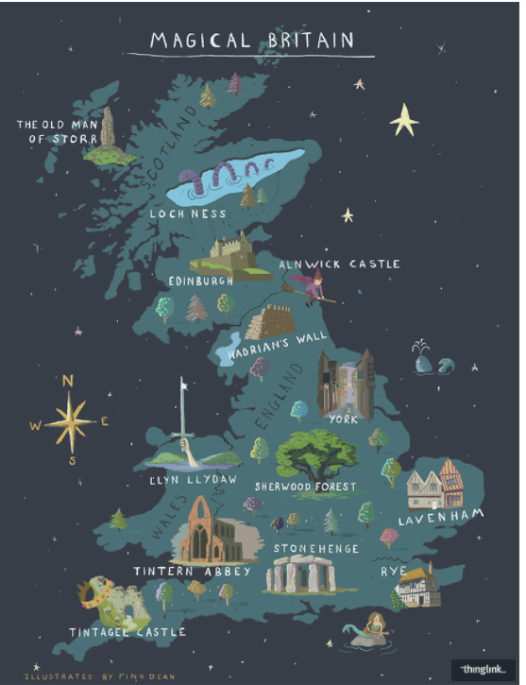
“Magical Britain” campaign uses Harry Potter to boost tourism
In 2017, VisitBritain launched a new campaign aiming to boost visitor numbers in the UK, announcing a year of literary milestones dubbed “Magical Britain”.
An interactive online map publicises sites across Britain which have inspired not only the likes of Harry Potter, but also the legends of Robin Hood, King Arthur and the Loch Ness Monster.
VisitEngland also named 2017 the Year of Literary Heroes to shine the spotlight on England’s literary destinations and anniversaries.

Slide 24
SECTION 3
MUSIC TOURISM

Slide 25
WHAT IS MUSIC TOURISM?
Music tourism describes travel undertaken to enjoy music (whether at concerts or festivals) and to visit places associated with famous musicians or musical forms. Popular music and musicians are often associated with particular destinations – their hometowns, places where their music developed, references to places in song lyrics, videos and even things album covers!

Slide 26
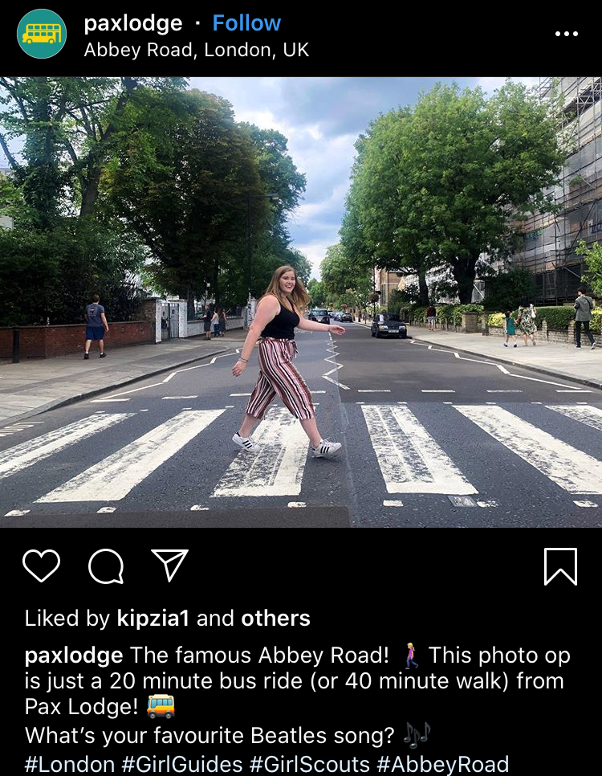
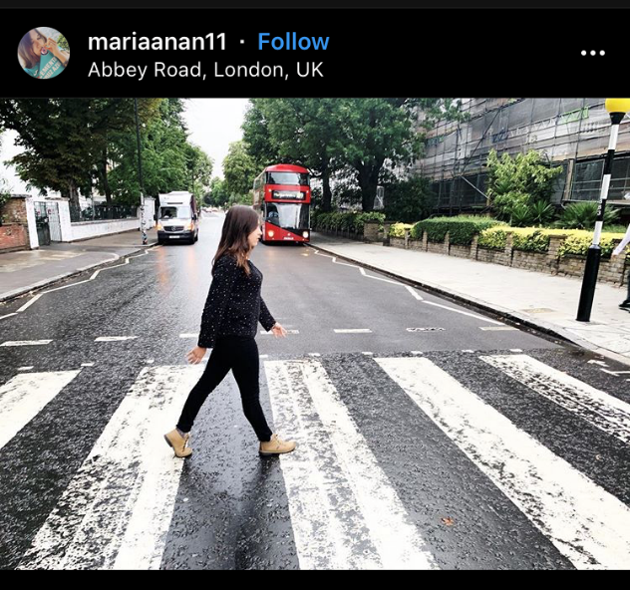
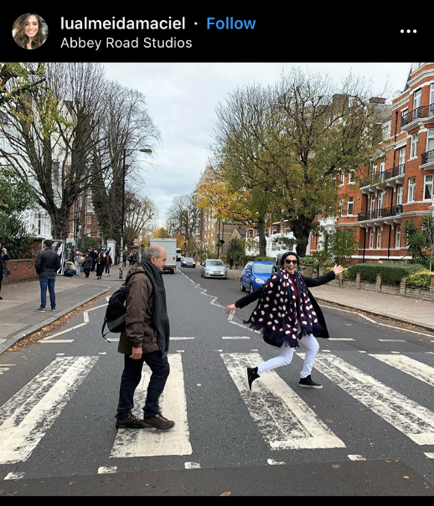
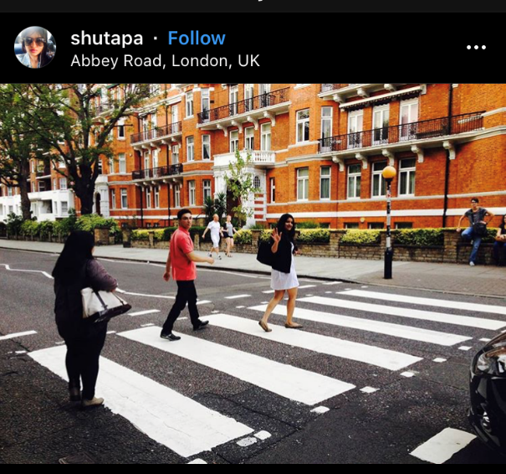
Music Tourists and Beatles fans recreating the famous Abbey Road Album cover in London. Abbey Road is a road in north west London that houses one of the world’s most famous recording studios, as well the famous Beatles zebra crossing.

Slide 27
Over a million people have visited the Fjadrárgljúfur canyon since Justin Bieber released his “I’ll Show You” video. Amazing to think! But such numbers brings challenges too. We will explore these in Module 5 and 6.

Slide 28
SECTION 4
LITERARY TOURISM

Slide 29
LITERARY TOURISM
Literary tourism refers to tourist trips to places associated with the life of a favourite author such as a writer’s house, birthplace or grave. It also relates to locations and settings of the fictional action described in works of literature. Additionally, book festivals, events and bookshops also attract literary visitors to particular locations around the world.

Slide 30
In Edinburgh, a little café regularly frequented by J.K Rowling author of Harry Potter has become a must visit spot for fans and literary tourists…

Slide 31
Castle Dracula is a unique pop culture tourism attraction that exploits Dublin’s connection to Dracula author Bram Stoker. In this video, you get to hear from some visitors (many tourists) who give their feedback on the experience

Slide 32
SECTION 5: COMICS, COSPLAY, VIDEO GAMES and more…

Slide 33
COMICS, COSPLAY, VIDEO GAMES and more…
Film/TV, Music and Literature are the big 3 – there are so many other interesting and niche subcultures worth exploring with regard to pop culture tourism. In the section that follows, we will take a look at a few. One in particular that offers untapped potential as it is not location specific though a good location is required. Intrigued? Let’s move on and find out more..

Slide 34
WHAT IS COSPLAY?
Comic conventions have steadily risen in popularity over recent decades and, as a corollary, so has cosplay a combination of the words 'costume' and 'play’. It might be just fun and games but cosplay is good for the economy. More than 133,000 cosplayers paid £20 to attend the London MCM Comic Con event annually. So this relatively new industry is generating money for the UK economy and across Europe.

Slide 35
CAN VIDEO GAMES INSPIRE TOURISM?
The answer is a definite yes. And gamers often visit the locations of their favourite games! In the next few slides, you will get to see some vlogs of gamers visits to locations from the Assassins Creed games.

Slide 36
Assassin's Creed is an extremely popular series of games based on time travel to the past. In this video, Lucie an avid gamer shares highlights of her trip to Italy to Florence, San Gimignano and Montereggioni, all mentioned in Assassin's Creed 2.

Slide 37
Footage from my trip to Rome, and how real life compares to the Assassin's Creed version

Slide 38
XBOX have realised the correlation between gaming and tourism and have launched a new campaign. “There are endless sights to see, mysterious places to explore and breathtaking landmarks to discover. This is not just gaming; this is gaming tourism. Embark on an epic journey today.”

Slide 39
MODULE 1 EXERCISE 1:
REFLECTION
Think about the different definitions of Pop Culture Tourism given in the introduction to this module. Do these definitions match what is happening in your region? Are there any omissions within the definitions – what might you like to add?

Slide 40
MODULE 1 EXERCISE 2: COMPILE A VIRTUAL SCRAPBOOK/MAP
Research examples of Pop Culture Tourism in your region and collect evidence of these in a virtual scrapbook that you can share. We will be referring to this scrapbook in later modules. Examples of materials that you might wish to gather include links to websites or weblogs, promotional materials such as scanned maps, leaflets or guides or other promotional materials. You might also wish to upload your own photographs of sites into your virtual scrapbook.
?

Slide 41
MODULE 1 EXERCISE 3:
COSPLAY AND VIDEO GAME TOURISM DISCUSSION
Refresh your memory on the definitions of cosplay and video game tourism provided in Module 1.
Consider the various opportunities for promoting cosplay and video game tourism in your region. Do you think that this is an appropriate form of tourism in your local setting? Please explain your point of view.

Slide 42
UP NEXT: Module 2 What do Pop Culture Tourists want?
(For some it’s a fairytale castle experience.. But what about the others? Join us in Module 2 to find out)

Slide 43
Key Sources/Resources in Module 1
www.facebook.com/outpaceeu
The Game of Thrones effect – how the TV series changed how we travel
The Cosplay Economy: How Dressing Up Grew Up
www.popculturetourism.eu

