Slide 1
What Do Pop Culture Tourists Want?
Module 2
Source

Slide 2
MODULE 2 CONTENTS
WHO ARE POP CULTURE TOURISTS AND WHAT DO THEY WANT?
1
LOCATION TOURISM
2
IMMERSIVE/ACTIVE EXPERIENCES
3
EMOTIONAL ESCAPES
4
5
FANDOM CONNECTIONS
This project has been funded with support from the European Commission. This publication reflects the views only of the author(s), and the Commission cannot be held responsible for any use, which may be made of the information contained therein.

Slide 3
SECTION 1
WHO ARE POP CULTURE TOURISTS AND WHAT DO THEY WANT?
Source

Slide 4
WHO ARE POP CULTURE TOURISTS?
Pop Culture tourists exhibit somewhat more complex motivations than traditional tourists’ travel motives to visit the destinations. Some have a passionate interest (i.e., fans) in a particular popular culture phenomenon, while for others the popular culture association of the place attracts them to visit for added value. For fans, the drama, entertainment, social interaction, and community connections are central to the experience.
Source

Slide 5
TOURISM THEN AND NOW
With the rise of modernity in the early twentieth century and the growth of popular culture since the 1950s people have looked to their favorite sports teams, musicians, films, TV series, books, comics, games, and celebrities to build a sense of identity and form social relationships with others.
Increases in the standard of living and leisure time have meant the tourist industry has also changed growing exponentially as new technologies and methods of travel open up every corner of the globe at relatively low cost.
What has become apparent in contemporary tourism is that fans of popular texts are more visible, willing to spend the money, and able to travel further in order to get close to and interact with their favorite film, TV show, or book.

Slide 6
WHAT DO POP CULTURE TOURISTS WANT?
Pop culture tourists make up a target group that builds on people's deep involvement with various films, television shows, books, sport, or music. For many pop culture tourists, this involvement permeates several aspects of their lives, such as fashion, personal relationships, blogging, education, and travel. Besides this, it is often an involvement that remains for a long time, making them a type of loyal customer who is happy to spread their interest to others.
Source

Slide 7
POP CULTURE TOURISTS: FILM TOURISM CASE STUDY
Fan consumption and demand for popular culture tourism can take a variety of forms, one of the most well known – film tourism
Film tourism is an increasingly complex phenomenon – it depends on a combination of personal characteristics of the viewer, such as emotional responsiveness, education, and cultural background, which makes film tourism a highly personalized experience.
Form of popular culture tourism is described as a modern form of pilgrimage in which the tourist walks in his/her favourite character's footsteps, sees what the character saw, does what the character did, and feels what the character felt at that specific place.
Source

Slide 8
Films begin to influence the possible demand of film tourists when they encounter the information about the film

Slide 9
SECTION 2
LOCATION TOURISM
Source

Slide 10
LOCATION TOURISM
Popular culture tourism encompasses destinations featured in popular culture expressions (e.g., film, television, literature, music, fashion, sports) and the people who travel to these places because of their association to the expression.
Source

Slide 11
- around 5 per cent of the world’s travellers are inspired by movies when selecting their holiday destination
- 20 per cent of international travellers credit films as a source of information that had an impact on their decision to travel to Ireland
- 36 per cent of the surveyed international tourists and 12 per cent of all domestic tourists in UK can be defined as film location tourists
Film and TV productions can put destinations on the map and increase tourism to screened locations
RECENT GROWTH OF POP CULTURE TOURISM

Slide 12
In this video some tourist destinations made famous through pop culture are presented

Slide 13
Popular culture tourism destinations often experience a strong marketing push to cultivate niche products and experiences in the wake of being featured in a popular culture medium.
One of the biggest challenges facing the tourism industry when investing in popular culture is building a cooperative relationship with the creative industries, e. g. tourism industry is built upon the dissemination of information about destinations and attractions to large target markets, while the film industry's logic is built upon limiting the spread of information about filming locations during preproduction and shooting.
Source

Slide 14
The major challenge as regards popular culture sites is how to use them while maintaining them for tourism purposes. It is also about finding a balance between exploiting a place for the purposes of popular culture tourism and retaining the place's authenticity, such as its local history and identity.
Source

Slide 15
Case study 2.1
#PaddingtonsBritain
‘If any of you ever make it to London, you can be sure of a very warm welcome’
National British destination marketing organization VisitBritain and film studio STUDIOCANAL collaborated in order to create a joint promotion. The entire process from the initial script assessment to the campaign launch took about a year and helped to establish a trusting relationship so that a number of intellectual property assets were transferred to VisitBritain, including the use of film stills, the use of the trailer and getting statements from cast and crew about London as a tourist destination.

Slide 16
Case study 2.2
Spectre in Tyrol
Production company’s strict copyright regulations prohibited the use of any film-related intellectual property, so Tyrol’s destination marketing organization Tirol Werbung implement a somewhat generic campaign headed by the slogan ‘Tirol, a great cinematic landscape’. Nevertheless, the overall advertising value equivalency (AVE) for the campaign amounted to 8.4 million euros, resulting in a return-on-investment AVE factor of 1 to 8.3.

Slide 17
Case study 2.3
Kakadu National Park in Australia
In their function as tourist attractions, film locations can be categorized in different ways. Some locations represent natural or man-made features with a pre-existing attraction status. An example would be Kakadu National Park in Australia. The park profited enormously from its exposure in the feature film Crocodile Dundee (1986).

Slide 18
“
In ’86, Australians hadn't even been to Kakadu, let alone Americans. Basically Kakadu was a mining area. Uranium was its biggest mineral. The government actually built a road from Darwin to Kakadu—not for tourism, but for mining.
”
Peter Hook
communications manager
at Kakadu Tourism
Source

Slide 19
Case study 2.4
Dark tourism
With an IMDb rating of 9.5 out of 10, 120 awards and 197 award nominations, Breaking Bad (2008–2013) is one of the most critically acclaimed TV shows of all time. Despite the brutality of the show, fans loved it and flocked to the locations in their hundreds in order to follow main character’s footsteps, making Breaking Badlocation visits a prime example of dark tourism. Despite its gritty content, the tourism industry in Albuquerque has embraced the opportunity to showcase the city and the region on the back of the show.

Slide 20
Music tourism and locations
Because of its abstract nature, music differs from other art forms in the way it evokes ideas of place. Linkages between music and place are called ‘detours’ : categories of associations between music and place:
music can be connected to place through instrumentation or musical structure
music can be connected to place through non-sonic aspects of music
biography of the composer or artist
specific places can become associated with music because they are the stage of its production, distribution or consumption
Source

Slide 21
Music tourism attracts audiences from different ages
Example: the ABBA walking tour in Stockholm is designed to attract tourists in their twenties and thirties. In reality, the tour attracts parents of around 40 years old and their tween children. This is because the parents were ABBA fans in their youth, and their children know ABBA from the MAMMA MIA! musical and movie.
Source

Slide 22
Celebrity cemetery tourism
Many cemeteries have worked to develop tourism programs that undo negative preconceptions and encourage a focus on heritage, architecture, or celebrity to draw visitors to their sites. Hollywood Forever Cemetery in Los Angeles is a forerunner in creating social events on the cemetery grounds. Visitors are invited to bring a picnic dinner and spread blankets on the lawn. Feature films are projected on the exterior wall of the Cathedral Mausoleum.
Source

Slide 23
SECTION 3
IMMERSIVE/ACTIVE EXPERIENCES

Slide 24
IMMERSIVE/ ACTIVE EXPERIENCES
More immersive, interactional, personalized, meaningful and engaging experiences are required that allow for community building that does not remain spatially and temporally restricted but extends beyond the space and place of the respective activity. The search for meaning, self and belonging will become increasingly relevant to popular culture tourists, and experiences need to be adapted to allow for this to happen.
Source

Slide 25
In a modern society where time is a precious resource, a truly good experience is time well-spent.
“
”
Joe Pine,
the co-author of
The Experience Economy
Source

Slide 26
Active experiences
Active Tourism is responsible travel to foreign areas requiring physical and mental participation from the tourist and following the maxims of sustainability, protection of Biodiversity and conservation of culture. Important elements are recreation and education, respect and contemplation, action, exercise and active involvement in company of an expert local friend, an academically competent tour guide.
Source

Slide 27
Virtual reality
Augmented reality
Mixed reality
With virtual reality, augmented reality and mixed reality becoming major growth stories, they are likely to enhance tourists’ desire for immersive experiences in future. Virtual reality headsets are already creeping into tourism – the British Museum used them for a temporary exhibition on Bronze Age roundhouses, for instance.
Source

Slide 28
Thomas Cook, started the “Try Before You Fly” campaign in 2017. The brand offers their customers the opportunity to choose their next destination through virtual reality.

Slide 29
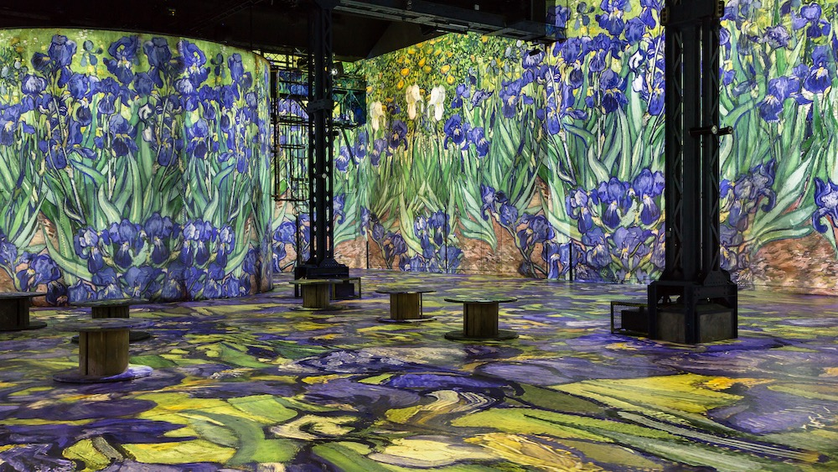
L’Atelier des lumières in Paris offers an “immersive show”: visitors discover the artworks projected on the floor and the walls.
Source

Slide 30
Museums are offering more and more immersive exhibitions, for example with this exposition on Claude Monet at the Horta gallery in Brussels.

Slide 31
A tourist attraction site in Fujian Province, China is giving visitors a chance to experience flying kung fu: it lets its customers waltz through the air and perform mesmerizing stunts like in the old kung fu soap operas of Chinese entertainment.

Slide 32
Visitor Preferences
While audiences like immersive visitor attractions, they particularly like the ones that combine virtual and physical experiences with a strong storyline.
When the experience is purely a simulation, audiences like to be able to handle objects at the same time. While people prefer physical objects, even being able to handle virtual objects is better than nothing.
Digital simulations are good for getting visitors to stay longer in a small space. This can either maximise the use of space or cause congestion, depending on the popularity of the experience.
People under 35s are the most comfortable with digital and virtual reality simulations, and also much more likely to want to experience them remotely.
Source

Slide 33
SECTION 4
EMOTIONAL ESCAPES
Source

Slide 34
EMOTIONAL ESCAPES
Source
Multiple motivations lead tourists to choose a destination. It is relative to irresistible desire to move back in time, to learn new things, to change ideas, to forget a daily loaded too much, to have a good time and to enjoy the pleasure of the emotion and the discovery. In this perspective, emotion is more representative of travel experience. It plays a central role in defining memorable experience.
Source

Slide 35
Tourism and emotions
Tourists today are more in search of positive emotions when they choice their vacation destinations. It is not enough to ensure and to offer a quality service that fits the standards, it is also important to consider this willingness among the tourist to live experience and feel emotion which contribute to maximizing satisfaction and creating a durable link.
Researchers set out the vision for a new economic era called the ‘experience economy’. According to this new concept consumers are looking for extraordinary, unique, individual and memorable experiences. And the emotions are set in the center of the experiences.
Source
Source

Slide 36
Tourists post experience behaviours (re-visit/recommend)
According to researches the entertainment, esthetics and escape dimensions are much more important predictor rather than education dimension in creating emotional arousal.
It could be said that tourist emotional reactions are fundamental determinants of post-experience behaviours and emotional arousal could be identified as antecedent of satisfaction and post experience intentions.
Emotional arousal has a positive effect on the post experience behaviours (re-visit/recommend). So, it is important for manager of the destination/hotel and travel agency to give the message to the tourist supplying the holistic emotional creation/arousal.
Source

Slide 37
SECTION 5
FANDOM CONNECTIONS
Source
Source

Slide 38
FANDOM CONNECTIONS
Fandoms – subcultures of people “typified by a feeling of closeness to others with the shared interest”.
Modern fan culture originated with Star Trek fandom in the 1960s. At the time, fans generally spread their creations through fanzines or conventions. The Internet has allowed fan culture to become more widespread and more accessible.
Source

Slide 39
“One of the problems for the modern traveller [...] is to establish identity and a sense of personal individuality in the face of the anomic forces of a technological world”
Source
Source

Slide 40
Tourists vs fans
Pop culture tourists are attracted by the different aspects of a destination that offer the potential to fulfill wishes and bring them closer to their favorite popular culture pastimes. However, fans are also driven by psychological and sociocultural motives that are more emotionally charged, seeking aesthetic pleasure, drama, interaction with icons and symbols, and fellowship in a group which shares routines, rituals, and a common fan language.
Groups of fans create shared meanings for each other; media networks, both online and offline, make it possible for them to exchange experiences and stories before, during, and after visiting tourist spaces.
Source
Source
Source

Slide 41
What do we have to know about fandoms?
Why do fans form active communities that extend their media influence?​

Slide 42
MODULE 2 EXERCISE 1:
THINK ABOUT THE MOTIVATIONS OF POP CULTURE TOURISTS
Describe the typical visitor to your region. Then, looking at your virtual scrapbook (see Module 1), consider what type of tourists might be attracted by your local Pop Culture Tourism sites. Can you categorise them into different groups (families, couples, seniors, Millennials, fans etc)? What do you think are the motivations of these different Pop Culture Tourist groups?

Slide 43
MODULE 2 EXERCISE 2:
EXPLORING WHAT POP CULTURE TOURISTS WANT
Find out if you have any Pop Culture Tourism sites in your region which have a strong fan base. Carry out some research on online fan forae/discussion groups/ fan club sites etc. – what are these fans looking to get out of a visit to the sites? How can Pop Culture Tourism sites cater to these fan visitors?

Slide 44
UP NEXT: Module 3 Creating Pop Culture Tourism Experiences and Products

Slide 45
Key Sources/Resources in Module 2
www.facebook.com/outpaceeu
Lundberg, C, Ziakas, V. 2018. The Routledge Handbook of Popular Culture and Tourism, 526 p.
Özlem Güzel, F. 2014. The dimensions of tour experience, emotional arousal, and post-experience behaviors: a research on Pamukkale in Turkey
www.popculturetourism.eu

