Slide 1
Creating Pop Culture Tourism Experiences and Products
Module 3
Source

Slide 2
MODULE 3 CONTENTS
WHAT YOU NEED TO BE A POP CULTURE TOURISM PROMOTER?
1
POP CULTURE TOURISM OPPORTUNITIES IN YOUR REGION AND MORE
2
SHORT STAY POP CULTURE TOURISM EXPERIENCES
3
LONG STAY POP CULTURE TOURISM EXPERIENCES
4
OTHER POP CULTURE TOURISM FESTIVALS AND EVENTS
5
This project has been funded with support from the European Commission. This publication reflects the views only of the author(s), and the Commission cannot be held responsible for any use, which may be made of the information contained therein.
Source

Slide 3
SECTION 1
WHAT YOU NEED TO BE A POP CULTURE TOURISM PROMOTER?
Source

Slide 4
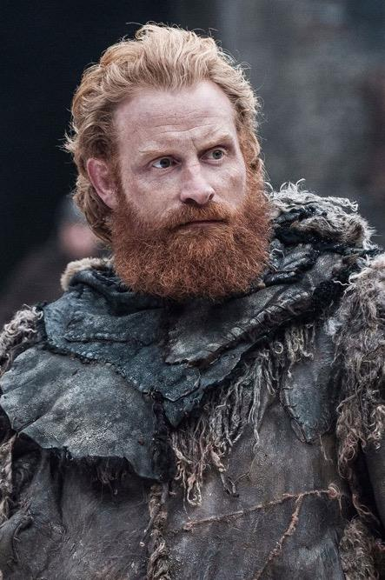
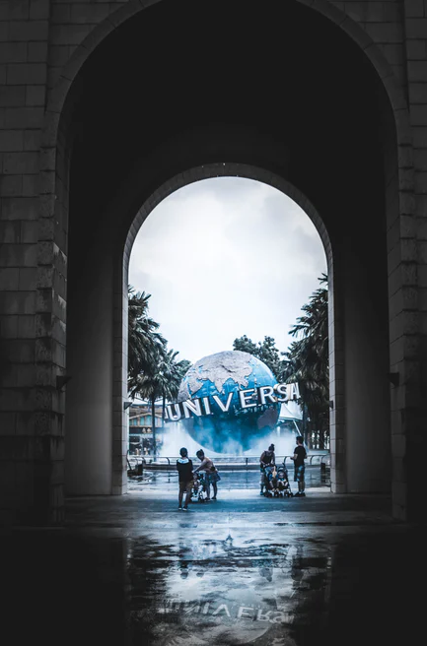
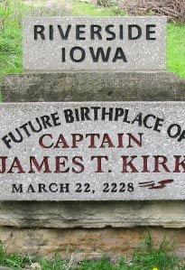
WHAT YOU NEED TO BE A POP CULTURE TOURISM PROMOTER?
Take into account..
Identify stakeholders
Work with stakeholders
Always be up-to-date
Be creative

Slide 5
POP CULTURE TOURISM PROMOTION
76% of travellers worldwide use travel review sites to plan their trip
48% of travellers worldwide listen to family and friends for advice on trip planning
93% of travellers worldwide say booking decisions are impacted by online reviews
For decades good advertising has influenced society and vice versa.
By capitalizing on trends and patterns in media and entertainment, city’s numbers can go up. From Game of Thrones-inspired tours to Breaking Bad souvenirs to Great Gatsby parties, destinations are raking in the visitors and the cash.

Slide 6
+ government
+ private sector
+ public support
Collaboration, authentic elements and information flow are the key elements
WHO IS RESPONSIBLE FOR POP CULTURE PROMOTION?

Slide 7
CREATE VISUAL CONTENT
These days, pop culture is everything. And with the advent of social media, trends are spreading quicker than ever, inspiring consumer behaviour and big-time spending in the blink of an eye.
With the rise of Pinterest, Instagram and other visual, photo and video-heavy mediums, imagery is the wave of the future.
40% of people will respond better to visual information than plain text: visual content drives engagement!
85% more likely to purchase a product after watching a product video

Slide 8
Case study: making Australia a top travel destination
Goal: Increase flight booking to Australia among US travellers.
Solution: Use Verizon Media native ads to drive highly qualified leads to Tourism Australia's website and boost travel bookings via partner websites.
Source

Slide 9
Diamonds Are Forever
Frances Gerety wrote "A Diamond Is Forever" for an advertising campaign for De Beers in 1947 and wrote all of the company's ads for 25 years.
“Diamonds Are Forever” was such a ubiquitous phrase it became the name of a James Bond flick.
Source

Slide 10
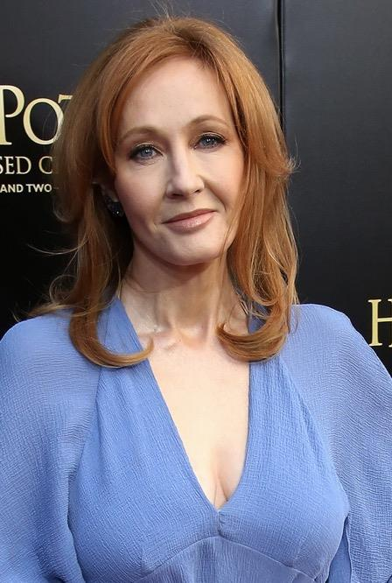
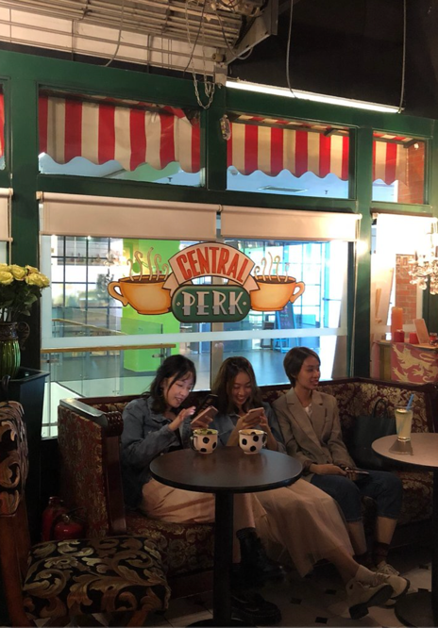
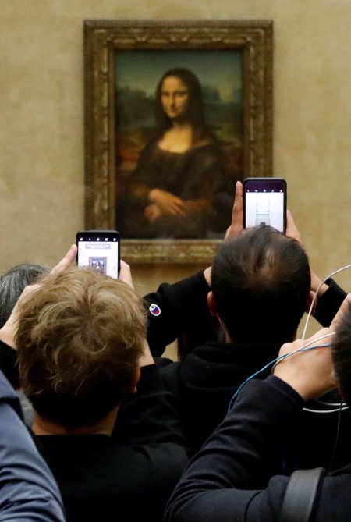
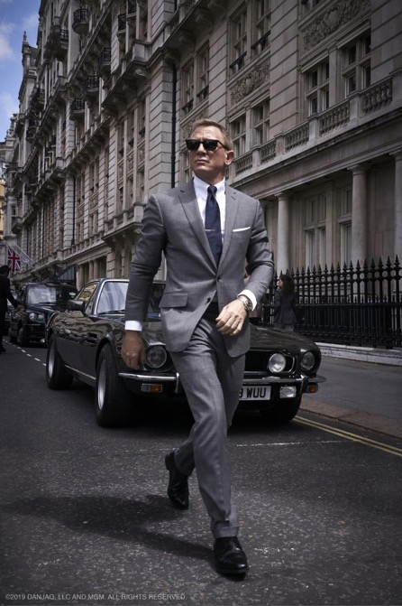
Collaborate with your stakeholders
Who are they?
Who produce, create, research write the films and books that influence pop culture
Hotels, restaurants, tour services, etc.
They have pre-conceived perception of what they will experience
Who play the roles of characters that attract followers
PEOPLE PRODUCING CONTENT
HOSTS AT THE DESTINATION SITES
POP CULTURE TOURISTS
ACTORS

Slide 11
BE UP-TO-DATE
Know the hottest movies, books and TV shows at any given time and find new ideas: hotel specials, destination-wide watch parties, etc.
Find creative ways to news jack, or jump on the bandwagon of a new trend or topic. Real time marketing is an excellent way to do this.
Wrap a deal or campaign around a pop culture trend or occasion.
Create themed content for country website and social media that is in keeping with current trends.

Slide 12
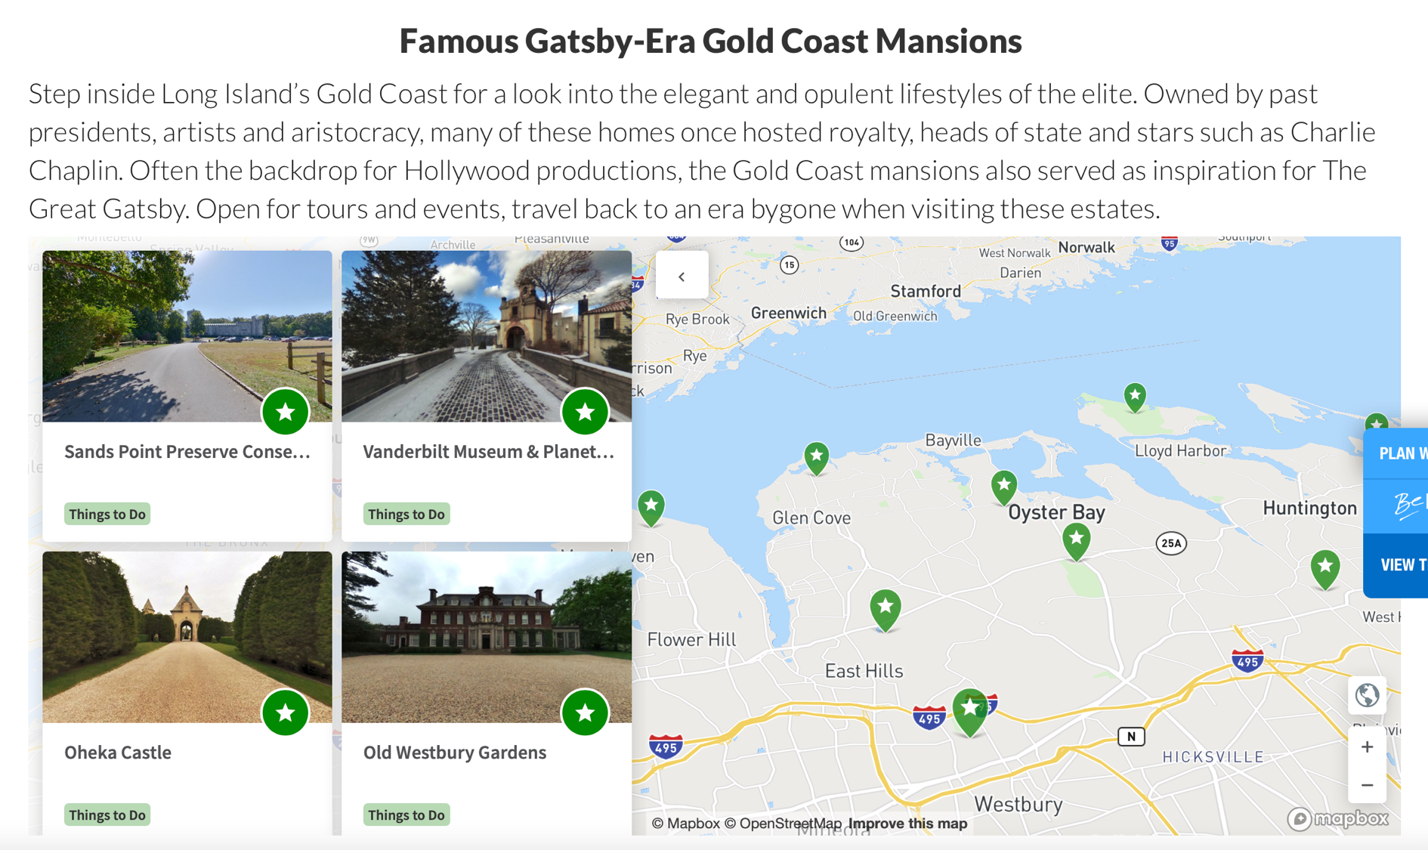
The Great Gatsby & The Mansions of Long Island's Gold Coast
Source

Slide 13
BE CREATIVE
When it comes to tourism, pop culture marketing often leans on a destination where a film, TV show or book was set.
But even if there are no filming locations in your country, there are plenty of alternatives. You can utilize pop culture trends to promote various aspects of your destination.
Communicate with film offices and be "film friendly" - take a proactive stance towards encouraging filming. Develop relationships with the major film studios, international and local PR companies and advertising agencies.
Pop culture promotion is all about thinking outside the box – coming up with creative ideas based on common themes and widespread trends, and real-time reactions.

Slide 14
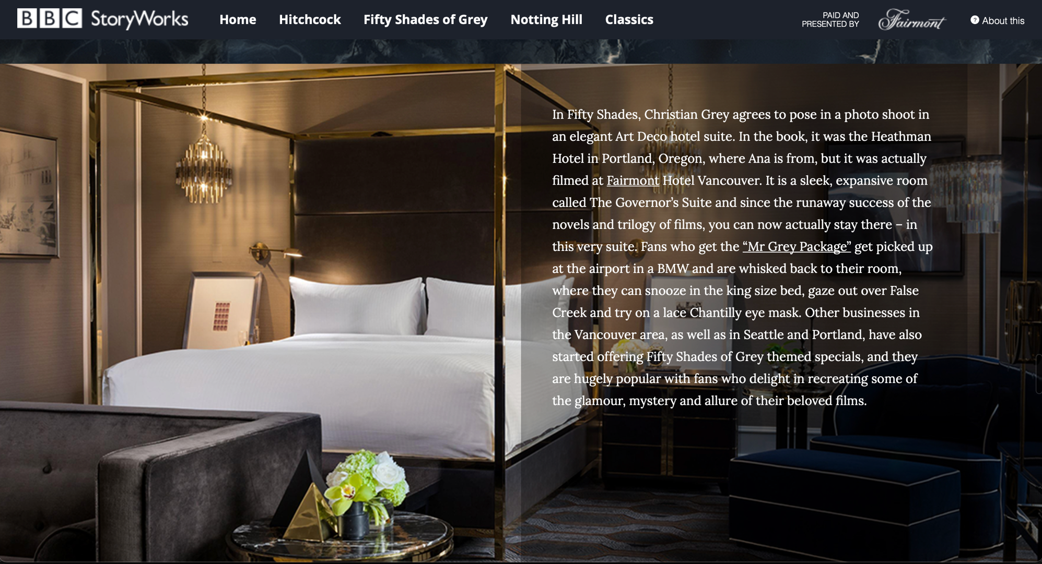
Fifty Shades of Grey themed specials
Source

Slide 15
SECTION 2
POP CULTURE TOURISM OPPORTUNITIES IN YOUR REGION AND MORE
Source

Slide 16
POP CULTURE TOURISM OPPORTUNITIES IN YOUR REGION AND MORE
Pop culture tourism is growing in popularity and many countries, regions and destinations are focusing on developing this sector to reflect the strong associations they may have with these themes.
In this section, we explore some of the world and Europe's most popular pop culture tourism destinations with a special focus on Iceland, Lithuania, UK and Sweden as they are the founding OUTPACE countries.
Source

Slide 17
THE 10 CITIES WITH THE GREATEST TOURIST HERITAGE
1. Amsterdam: 96 theatres, 81 museums, 54 art galleries, 2 World Heritage Sites, 8 concert halls, 43 Michelin Guide restaurants.
2. Dublin: 127 theatres, 57 museums, 32 art galleries, 6 concert halls, 5 Michelin Guide restaurants.
3. Prague: 129 theatres, 110 museums, 201 art galleries, 1 World Heritage Site, 4 concert halls, 3 Michelin Guide restaurants.
4. Miami: 72 theatres, 18 museums, 27 art galleries, 1 World Heritage Site, and 1 concert hall.
5. Paris: 245 theatres, 147 museums, 69 art galleries, 1 World Heritage Site, 6 concert halls, 100 Michelin Guide restaurants.
6. Barcelona: 80 theatres, 95 museums, 46 art galleries, 1 World Heritage Site, 3 concert halls, 25 Michelin Guide restaurants.
7. Milan: 43 theatres, 76 museums, 42 art galleries, 1 World Heritage Site, 4 concert halls, 17 Michelin Guide restaurants.
8. Rome: 93 theatres, 151 museums, 42 art galleries, 5 World Heritage Sites, 3 concert halls, 18 Michelin Guide restaurants.
9. Vienna: 55 theatres, 103 museums, 14 art galleries, 2 World Heritage Sites, 7 concert halls, 9 Michelin Guide restaurants.
10. London: 878 theatres, 186 museums, 125 art galleries, 4 World Heritage Sites, 17 concert halls, 67 Michelin Guide restaurants.
Source

Slide 18
TOP DESTINATIONS FOR POP CULTURE INCLUDE (1)
FILMS - Los Angeles, California area film studios - New York City, New York urban area featured in hundreds of Hollywood and American films - Salzburg, Austria, where many scenes from The Sound of Music (1965) were filmed - Tunisia, location of the filming of the Star Wars films, began in 1977 - The Field of Dreams, a baseball field featured in the 1989 film of the same name - Petra, Jordan, where visits went from the thousands to the millions after the climactic scene of the 1989 film Indiana Jones and the Last Crusade was filmed in Al Khazneh - Wallace Monument, Stirling, dedicated to Scottish hero William Wallace. Saw a visitor rise of 160,000 after the 1995 film Braveheart - Burkittsville, Maryland, where tourists re-create the most gruesome scenes from the 1999 film The Blair Witch Project - New Zealand, after The Lord of the Rings (2001–2003) was filmed there - Alnwick Castle, location of Hogwarts in the Harry Potter film series (2001–2011) - Santa Ynez Valley in Central California where much of the 2004 film Sideways took place - Rosslyn Chapel, Scotland and Lincoln Cathedral, England. Locations used in The Da Vinci Code (film) film (2006) - Brevard and Transylvania County, North Carolina. Filming location of The Hunger Games (2012) - Norway, where tourism increased after the 2013 Pixar film Frozen was released
You can find lots of interesting tourism insights and information on these online, we recommend studying these destinations in more detail!

Slide 19
TOP DESTINATIONS FOR POP CULTURE INCLUDE (2)
FOLKLORES - Loch Ness in the Scottish highlands, home of the mythical Loch Ness Monster - Sherwood Forest, Nottinghamshire, England, associated with Robin Hood - Tintagel Castle in South-West England, association with King Arthur
LITERATURE - Ashdown Forest, East Sussex, England, setting for Winnie-the-Pooh in the 1920s - Stratford-upon-Avon, Warwickshire, England, birthplace of William Shakespeare (1564–1616), receives about 4.9 million visitors a year from all over the world - Prince Edward Island, in which the 1908 Canadian novel Anne of Green Gables takes place, is a popular attraction for tourists, notably from Japan where the first translated edition was published in 1952 - Forks, Washington, primary setting of the Twilight series of novels and films.
MUSIC - Abbey Road, London, known by the 1969 album Abbey Road by The Beatles whose cover features the Beatles walking across the zebra crossing of the road - Liverpool, England, for fans of The Beatles. A museum dedicated to them ‘The Beatles Story’ is situated at the Albert Dock - Graceland, Memphis, Tennessee, a mansion which was owned by Elvis Presley. It serves as his biographical museum since 1982
You can find lots of interesting tourism insights and information on these online, we recommend studying these destinations in more detail!

Slide 20
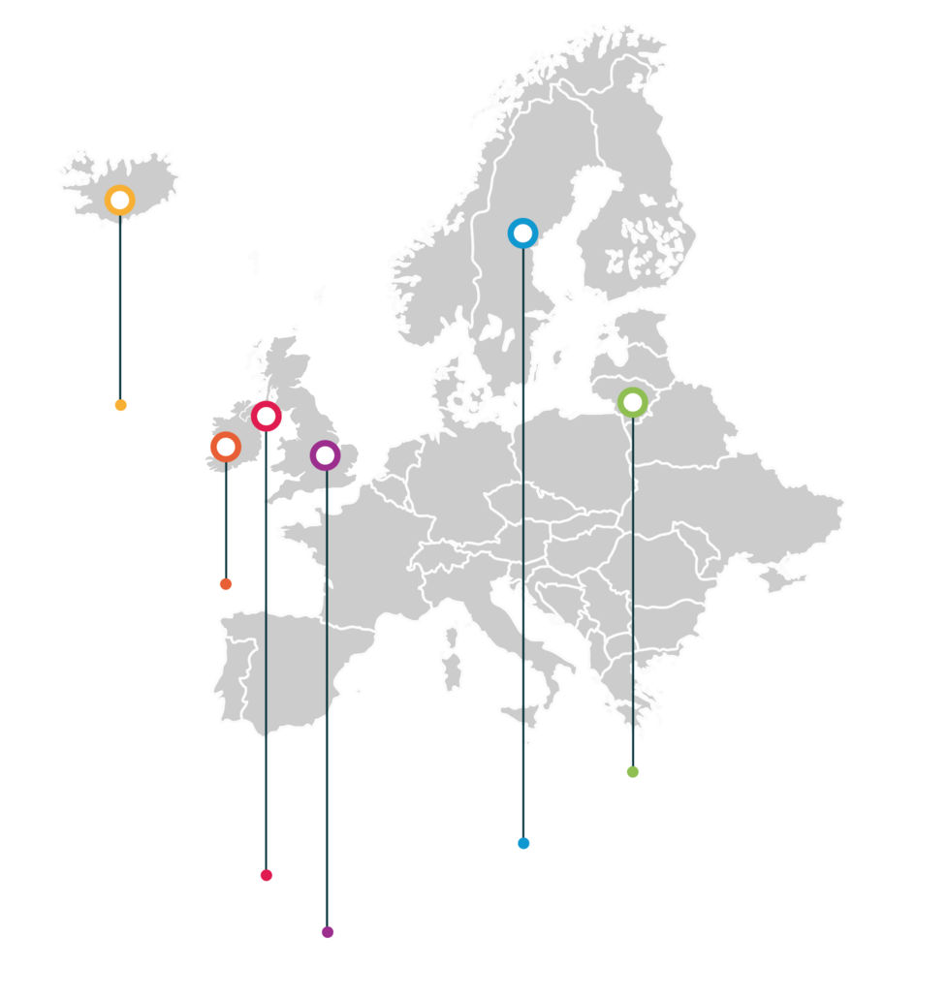
Let’s take a look at some pop culture tourism opportunities in the OUPTACE partner regions of Iceland, Ireland, Northern Ireland/UK, Sweden and Lithuania..
Iceland
Ireland
Lithuania
Northern Ireland
Sweden
UK

Slide 21
ICELAND – the land of fire and ice!
On Feb 9, 2021, The Academy of Motion Picture Arts and Sciences announced the shortlists for the 93rd Academy Awards®. Fifteen songs were announced for the Original Song category. Among the songs announced was 'Husavik' from the Netflix film 'Eurovision Song Contest: The Story of Fire Saga’. A village used this unique opportunity to revitalize the town and its tourism through this film and the song 'Husavik'.
Source

Slide 22
TOP 15 FILMS AND TV SHOWS FILMED IN ICELAND
1. James Bond Series: A View to a Kill (1985) and Die Another Day (2002) - Jökulsárlón Glacier Lagoon 2. The Star Wars Saga - Epic Locations Spanning across Iceland 3. The Game of Thrones Series 4. Tomb Raider 5. Batman Begins 6. The Secret Life of Walter Mitty 7. Oblivion 8. Interstellar 9. Fast & Furious 8 10. The Tree of Life (2011) - Krafla Volcano and Námafjall, North Iceland 11. Journey to the Center of the Earth (2008) - Snæfellsjökull National Park 12. Prometheus (2012) - Hekla Volcano and Dettifoss Waterfall 13. Thor: The Dark World (2013) - Landmannalaugar, Dettifoss, Skógafoss 14. Noah (2014) - All over Iceland 15. Captain America: Civil War (2016) - Vík, South Iceland
Source

Slide 23
LITHUANIA: 2019 historical drama television miniseries Chernobyl revolves around the Chernobyl disaster of 1986 and the clean up efforts that followed. The series was produced by HBO in the United States and Sky UK in the United Kingdom and filmed in Lithuania and Ukraine.
Source

Slide 24
The crew of the hit Netflix series Stranger Things was in Vilnius filming part of the show’s fourth season. Shooting took place at locations around the Lithuanian capital, including the recently closed century-old former prison.
The prison, which was built and began holding inmates in the early 1900s, just ceased operations in 2020. During the tumultuous 20th century in Vilnius, interchanging regimes – including Imperial Russia, the Soviet Union, Nazi Germany, and finally, independent Lithuania – all used the structure as a prison.
Source

Slide 25
#nanoJesus – collaboration between Vilnius city, university and business: a nativity scene in Cathedral Square in Vilnius scanned and 3D printed in nanoscale proportions, gifted to Pope Francis just before Christmas.

Slide 26
United Kingdom is one of the most popular travel destinations in the world with fascinating history, exciting cities, and rich cultural traditions.
From The Beatles to Harry Potter and Sherlock Holmes – the list is never ending.
Source

Slide 27
8 TOP LONDON FILM AND POP CULTURE LOCATIONS TO VISIT
1. The Black Prince, Kingsman
2. Old Royal Naval College, Les Miserables
3. The Blue Door, Notting Hill
4. Islington Andover Estates, Chewing Gum
5. Les Ambassadeurs
6. Statue of Havelock
7. Over 70 different films, South Bank
8. Platform 9 ¾, Harry Potter
Source

Slide 28
Northern Ireland is home the Game of Thrones studio (in Belfast) for all the interior sets and many exterior locations.

Slide 29
TOP FILMS FILMED IN IRELAND AND THE MOST BEAUTIFUL LANDSCAPES
Game of Thrones (locations: The Dark Hedges, Carrick-a-Rede Rope Bridge, Cushendun Caves, Ballintoy Harbour, Larrybane Chalk Quarry)
Harry Potter (The Cliffs of Moher - Horcrux Cave)
The Princess Bride (The Cliffs of Moher - Cliffs of Insanity)
Star Wars (Malin Head, Skellig Michael)
Lord of the Rings (Burren)
Source

Slide 30
Sweden is well known for the great music and one of the greatest pop careers in musical history - ABBA. ABBA The Museum is a Swedish interactive exhibition about the pop band ABBA that opened in Stockholm, Sweden in May 2013.
Source

Slide 31
SECTION 3
SHORT STAY POP CULTURE TOURISM EXPERIENCES
Source

Slide 32
Universal Studios Hollywood theme park
Universal Studios is located in Hollywood, capital of the American film industry. This movie-studio-themed park has attractions that include behind-the-scenes tours of movie sets as well as rides based on your favorite feature films, including attractions as: The Wizarding World of Harry Potter, Jurassic World - The Ride, Fast & Furious – Supercharged, Springfield - The Simpsons Ride™, Transformers™: The Ride–3D, Studio Tour, etc.
Source

Slide 33
Disneyland Park was opened in 1955 in California. Disneyland has a larger cumulative attendance than any other theme park in the world, with 726 million visits since it opened (as of December 2018). In 2018, the park had approximately 18.6 million visits, making it the second most visited amusement park in the world that year, behind only Magic Kingdom, the very park it inspired.

Slide 34
Madame Tussauds wax museum in London and in a number of other major cities displays the waxworks of famous and historical figures, as well as popular film and television characters played by famous actors. It was founded by wax sculptor Marie Tussaud in 1835.
Source

Slide 35
Akihabara is a common name for the area around Akihabara Station in the Chiyoda ward of Tokyo, Japan. Akihabara is considered by many to be the centre of modern Japanese popular culture and a major shopping district for video games, anime, manga, electronics and computer-related goods.

Slide 36
Game On is the first major international touring exhibition to explore the history and culture of computer games. The exhibition was first shown at the Barbican Centre in 2002 and has since been toured by Barbican International Enterprises to over 20 countries worldwide. It has been seen by over 2 million people across the globe.
Source

Slide 37
SECTION 4
LONG STAY POP CULTURE TOURISM EXPERIENCES
Source

Slide 38
U.S. Route 66
U.S. Route 66 established in 1926 became one of the most famous roads in the United States. American pop-culture artists publicized US 66 and the experience, through song and television. Bobby Troup wrote "(Get Your Kicks on) Route 66", and the highway lent its name to the Route 66 TV series in the 1960s. Disney/Pixar's 2006 animated film Cars had the working title of Route 66, and describes the decline of a once-booming Radiator Springs, nearly a ghost town once its mother road, US 66, was bypassed by Interstate 40. Disney/Pixar's creative director John Lasseter, inspired by what he saw during a cross-country road trip with his family.
Source

Slide 39
Family Pop Culture Tour of England
Tourism companies in Great Britain organize a 7-day tour for families, which include different visits and information about modern English cultural exports, including Alice in Wonderland, Mary Poppins, The Beatles, and Harry Potter.
Source

Slide 40
SECTION 5
OTHER POP CULTURE TOURISM FESTIVALS AND EVENTS
Source

Slide 41
Music Festivals
Numbers of music festivals are being organized worldwide, attracting many tourists to hear their idols. Coachella, Sound On Sound Fest, Lollapalooza, Mutek, Field Day, Fuji Rock and many more..
Source

Slide 42
Oregon Shakespeare Festival
Often called the Broadway of the West Coast, the Oregon Shakespearean Festival (OSF) is one of the region's biggest attractions, boasting multiple Tony Awards and accolades. February through November, Oregon Shakespearean Festival produces 11 world-class productions by classical and contemporary playwrights, crafted by some of the biggest talents in theater today and attracts approx. 400,000 visitors annually.
Source

Slide 43
Comic-Con
The first Comic-Con event was hosted already in 1970, this event has however only in the past two decades or so sprung up to be a worldwide event phenomena bringing together over a hundred thousand people from across the world annually. These events have been also successful in recent times thanks to the expansion and success of Marvel and DC comic books into other mediums such as films and tv properties as well as video-games.
Source

Slide 44
K-pop events. K-pop has become a truly global phenomenon thanks to its distinctive blend of addictive melodies, slick choreography and production values, creating basis for the number of festivals yearly across the world.
From the mid-2000s to the early 2010s, the spread of the Korean Wave (Hallyu) was mainly led by Korean boy groups and girl groups called idol stars such as Big Bang, Girls’ Generation, and Kara. During this period, the Korean Wave extended its fan base into the global stage, including Latin America and the Middle East beyond Asia, especially loved by young people in their teens and 20s. Now there are nearly 100 million Hallyu-related organizations in all countries around the world.
Source

Slide 45
Burning Man Festival
The Burning Man festival is a community event where tens of thousands of people gather in Nevada's Black Rock Desert to create Black Rock City, a temporary and flourishing cityscape. The event originated on June 22, 1986, on Baker Beach in San Francisco as a small function organized by Larry Harvey and Jerry James, the builders of the first Man. It has since been held annually, spanning the nine days leading up to and including Labor Day. In 2019, 78,850 people participated in the event.
Source

Slide 46
Fighting Game Tournaments
The Evolution Championship Series, or EVO for short, is the most prestigious fighting game tournament in the world. Every year, thousands of fighting game fanatics come from around the world to compete in their respective games. Winning an EVO title is a surefire way to secure your name in the fighting game history books.
Source

Slide 47
MODULE 3 EXERCISE 1:
PLAN A POP CULTURE TOURISM TRAIL/TOUR
Plan an interpreted trail which explores a Pop Culture Tourism theme in your locale. The trail could be a walking, driving or cycling route to provide a short or longer experience for visitors. Establish the theme. List the different types of locations, sites and businesses that you would include in the trail. Decide on the most appropriate interpretive format for your trail (map based, audio, app, information panels). Consider the potential benefits that this trail might bring to your visitors and to the region.

Slide 48
MODULE 3 EXERCISE 2:
CREATE A POP CULTURE TOURISM ELEVATOR PITCH
Create an elevator pitch for a new PCT event in your region. An elevator pitch is so called because it mimics the time it takes to ride in an elevator (let’s be generous and say around 2 minutes) in which you have time to pitch your event succinctly and persuasively.
In essence, the following bullet points are the template for structuring your pitch (https://toggl.com/blog/elevator-pitch-examples )
.

Slide 49
MODULE 3 EXERCISE 2:
CREATE A POP CULTURE TOURISM ELEVATOR PITCH
There are 5 main elements to an elevator pitch, these are:
State the Problem Present Your Solution Explain Why People Should Trust You Describe Your Value Proposition Offer a CTA (Call to Action)

Slide 50
MODULE 3 EXERCISE 2:
CREATE A POP CULTURE TOURISM ELEVATOR PITCH
Embed a call to action – what do you want the listeners to do when they’ve heard your pitch? Buy tickets/invest/ volunteer/tell their friends, or something else?
Follow this link for inspiration:
https://articles.bplans.com/the-7-key-components-of-a-perfect-elevator-pitch

Slide 51
UP NEXT: Module 4 Marketing pop culture tourism experiences and products
(How countries achieve their target audiences? Become a PRO!)

Slide 52
Key Sources/Resources in Module 3
www.facebook.com/outpaceeu
Radomskaya, V. POPULAR CULTURE TOURISM: TREND OR TRANSITION?
Radomskaya, V. Popular culture as a powerful destination marketing tool: an Australian study
Barbee, J. Pop Culture Marketing in Tourism
Eklind, A., Gracia Tjong, R. J. Understanding pop culture tourism – analysis of incentives for travel behaviour and participation of pop-culture tourism products
www.popculturetourism.eu

