Slide 1
Marketing Pop Culture Tourism Experiences and Products
Module 4

Slide 2
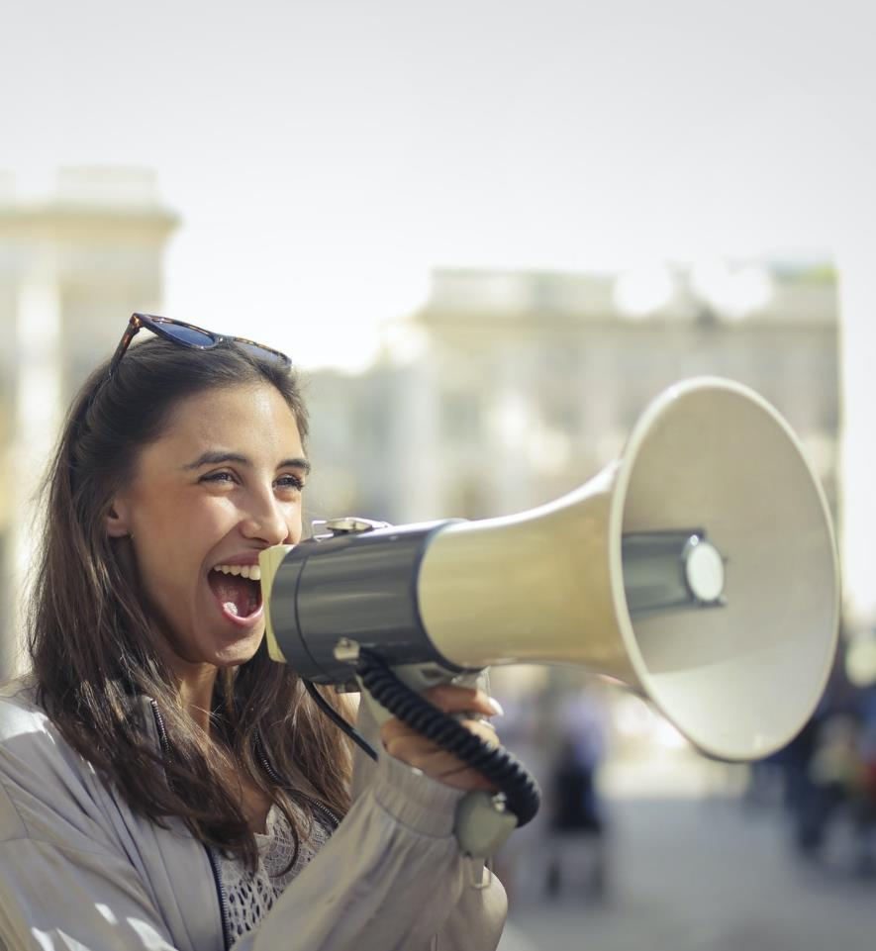
MODULE 4 CONTENTS
INTRO: WHY POP CULTURE TOURISM NEEDS SPECIAL MARKETING
1
BUILDING YOUR POP CULTURE TOURISM BRAND
2
LEVERAGING POWER OF POP CULTURE FANDOM
3
SPOTLIGHT ON USER GENERATED CONTENT
4
CELEBRITY AND INFLUENCER MARKETING
5
This project has been funded with support from the European Commission. This publication reflects the views only of the author(s), and the Commission cannot be held responsible for any use, which may be made of the information contained therein.

Slide 3
SECTION 1
WHY POP CULTURE TOURISM NEEDS SPECIAL MARKETING

Slide 4
Pop Culture Tourism requires a special marketing mix
With the advent of social media, pop cultures trends are spreading quicker than ever and inspiring consumer behavior and big-time spending in the blink of an eye. But pop culture and marketing going hand in hand is not a new phenomenon. For decades good advertising has influenced society and vice versa. From Game of Thrones-inspired tours, Harry Potter souvenirs and Great Gatsby parties, the business and marketing opportunities are ripe for the picking
Source

Slide 5
As we learned in Module 2..
Tourists vs fans
Pop culture tourists are attracted by the different aspects of a destination that offer the potential to fulfill wishes and bring them closer to their favorite popular culture pastimes. However, fans are also driven by psychological and sociocultural motives that are more emotionally charged, seeking aesthetic pleasure, drama, interaction with icons and symbols, and fellowship in a group which shares routines, rituals, and a common fan language.
Groups of fans create shared meanings for each other; media networks, both online and offline, make it possible for them to exchange experiences and stories before, during, and after visiting tourist spaces.
Source
Source
Source

Slide 6
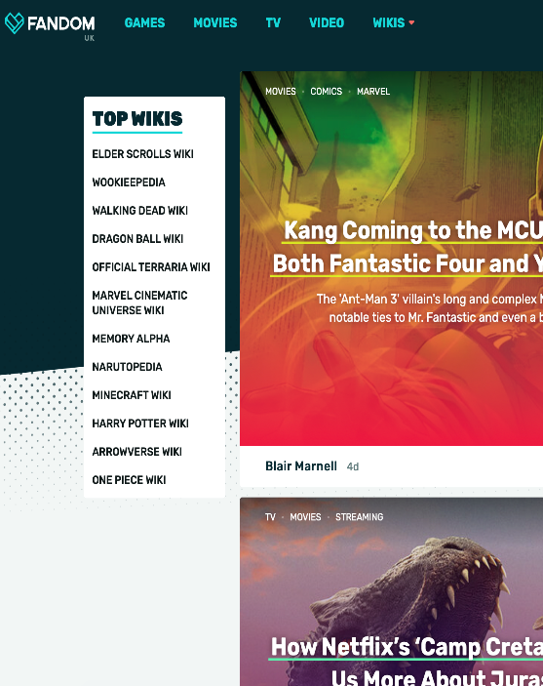
WHY POP CULTURE TOURISM NEEDS SPECIAL MARKETING
Pop culture communities
Like-minded fans and pop culture communities gather on social media platforms through various interests such as; trending music, current fashion, the latest cult movies and box sets.
These communities are consuming content and products of all kinds.
A whole new approach to marketing and business development treats these communities as co-creators with entrepreneurs.
https://www.fandom.com

Slide 7
Popular culture is highly influenced by mass media, creating rapid change, especially in a highly technological world in which cultures can evolve and spread through the internet and be consumed globally. Recently we have seen the rapid rise of Tik Tok and opportunities for online performers of all kinds.

Slide 8
Thetravelergene uses TIKTOK to help her 429k followers get lost in a fairytale, and many of those fairytales are linked to pop culture tourism…. www.tiktok.com/@thetravelergene

Slide 9
Fandom and Fan Loyalty – an important factor in Pop Culture Tourism Marketing
WHY POP CULTURE TOURISM NEEDS SPECIAL MARKETING
Fans are interested in minor details and spend a significant portion of their time and energy involved with their interest, often as a part of a social network with particular practices (a fandom).
Fan loyalty allegiances can be very strong – and can motivate them to visit the real or fictious locations associated with their favourite pop culture manifestations.

Slide 10
SECTION 2
BUILDING YOUR POP CULTURE TOURISM BRAND

Slide 11
BUILDING YOUR POP CULTURE TOURISM BRAND
A strong pop culture tourism brand needs to have a powerful identity, drive consumer behavior, influence perceptions of reality, inspire excitement in the visitor and encourage them to create some user generated content. Pop Culture Tourism as we have learned is are often about strong place connections. A strong pop culture tourism brand must deliver distinctive, compelling, memorable and rewarding experiences for fans. Let’s take a look at some..

Slide 12
Pop Culture Tourism is all about great imagery, landscapes and destinations. Liverpool has fully embraced its Peaky Blinders Connection – one example is The Peaky Blinders Bar which looks like a scene from the movie!

Slide 13
Visuals play an important role in pop culture tourism marketing. Visuals are powerful. Did you know? 40% respond better to visual information than plain text 85% more likely to purchase a product after watching a product video

Slide 14
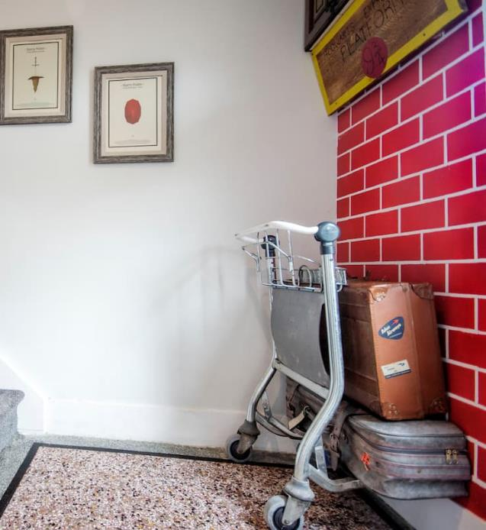
An Air BNB in Ireland makes for magical stays..
It might be far from the real Hogwarts (Alnwick Castle Northumberland) but Roscommon, Ireland offers its own magical experience in the form of Draiocht House. Draiocht (Gaelic for MAGIC) is what you really get with this property in abundance.
Touching on the Harry Potter world every bedroom has a theme and all over the house vistors find creative genius' and memories ready for making.
Roscommon has no connection to the world of Harry Potter, great visuals, vision and interior design is what makes this special..

Slide 15
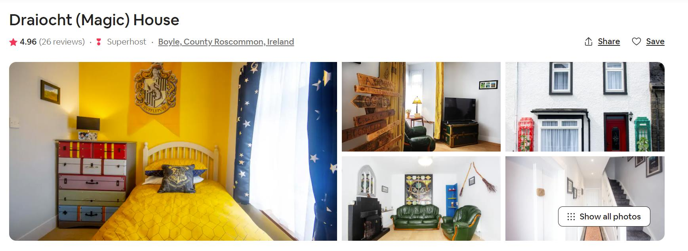
The Reviews give a sense of not only how magical the house is but the magical experience and memories it provides for Harry Potter fans

Slide 16
SECTION 3
LEVERAGING POWER OF POP CULTURE FANDOM

Slide 17
In this video, Alexandre O. Philippe a self-confessed pop culture geek give us a great insight into pop culture, fans of pop culture, why its all important and how it connects us..

Slide 18
Pop Culture Conventions
and Festivals
Pop Culture Conventions cater to fandom and their interests in film, comics, anime, television shows, cosplay. They offer fans the opportunity to buy and sell related merchandise.

Slide 19
Emerald Isle Garrison brings Invasion NI Star Wars convention to the Eikon Exhibition Centre at the Maze outside Lisburn, Co Antrim. Fans were able to see life-sized replica props, along with sets and iconic characters - such as stormtroopers and Darth Vader on the set.
Some celebrity guests were also in attendance, namely Admiral Piett (Kenneth Colley) and Logray the Ewok (Mike Edmonds).
Thousands of fans visited the convention over the course of the weekend
Source

Slide 20
Recognised as the largest Viking Festival in Europe, the annual JORVIK Viking Festival is a city-wide celebration of York’s Viking heritage
The festival’s programme of family-friendly events, lectures, guided walks and battle re-enactments attracts over 50,000 visitors each year from across the globe, with many returning year after year to take part and enjoy the atmosphere.
Source

Slide 21
SECTION 4
SPOTLIGHT ON USER GENERATED CONTENT

Slide 22
What is User Generated Content?
User-generated content (UGC) is any form of content, such as images, videos, text, and audio, that has been posted by users on online platforms such as reviews, social media and wikis. It something which consumers create to disseminate information online about products or services. Pop culture tourism is heavily reliant on fandoms and this means UGC is a super important marketing tool…

Slide 23
85% of users find visual user generated content (UGC) more persuasive than brand photos or videos.
That's why user generated content is considered content marketing gold.

Slide 24
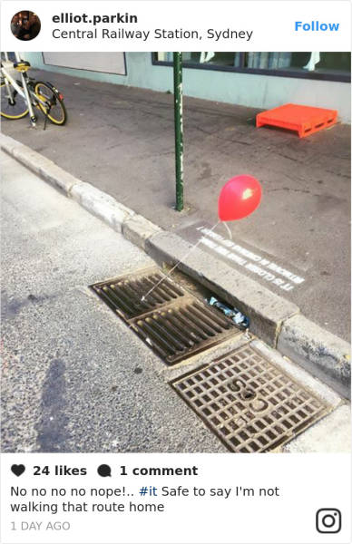
When Guerilla Marketing and User Generated Content Combined..
The Monday morning before the IT movie was released in Sydney, these creepy red balloons and slogans cropped up around the cities sewers… needless to people loved it and took to social media…
Three tactics we can learn from this which help build excitement around your brand on social media:
Use a creative marketing hook
Make use of teasers, sneak peeks and hints…
Play on people’s emotions

Slide 25
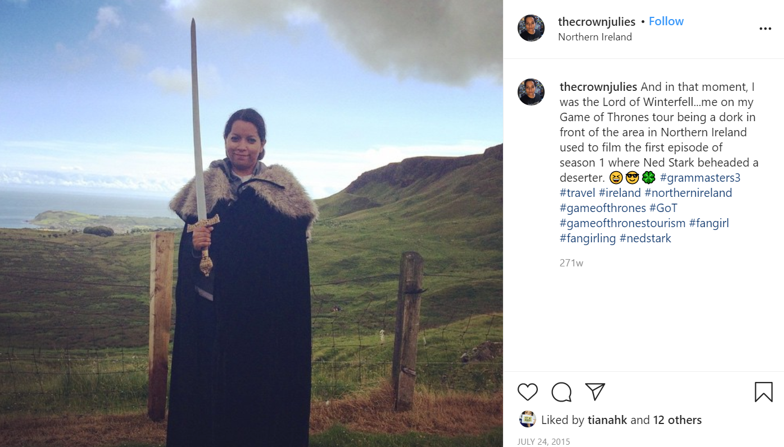
Pop culture tourism experiences like this make for an “instagrammable” pic and user generated content! TOP TIP: Embed photo opportunities in your experience!

Slide 26
SECTION 5
CELEBRITY/INFLUENCER, VIRAL/GUERILLA MARKETING
This Photo by Unknown Author is licensed under CC BY

Slide 27
Who are influencers?
This Photo by Unknown Author is licensed under CC BY-SA-NC
Influencers are typically social media users with thousands of followers and high quality content. By collaborating with influencers who are relevant to your target audience, you may significantly increase your reach. The downside is that this tends to be relatively expensive but can be worth it, especially in the early stages to help align your experience to your pop culture tourism opportunity.

Slide 28
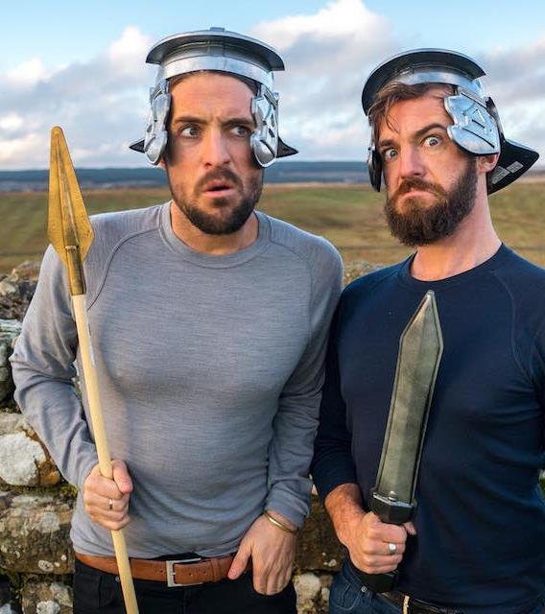
Spotlight on some Influencers – Meet the Vagabrothers!
“Vagabrothers” is a YouTube channel that is run by two brothers known as Marko and Alex Ayling. Their mission is to explore the planet by connecting with other young people and inspiring viewers to do the same. While doing so, they partner with travel industry partners with the most cutting-edge opportunities for advertising and content creation aimed at young, international travelers.
Influencers like the Vagabrothers typically create User Generated Content – these two techniques together are quite powerful… let’s take a look...

Slide 29
In this video, we see the Vagabrothers travel to York, England for the Jorvik Viking Festival. Watch them get dressed in armor and take part in a battle Viking and Saxon warriors! Could there be a better adverstisement?

Slide 30
GUERILLA MARKETING
To stand out from the crowd of brands and products, sometimes drastic measures need to be taken. Guerrilla marketing is one of these. It involves a high risk but also a high pay-out in the event of success. Using unconventional tactics and employing the element of surprise generally defines Guerrilla campaigns, as well as having a high degree of creativity.

Slide 31
Benefits of Guerilla Marketing
Quick to impact
Makes heads turn
Doesn’t necessarily involve outrageous spend
Creative minds can come up with the strategy
Puts across the brand’s value proposition in a clever manner

Slide 32
In 2018, the Australia’s Tourism Board created a spoof movie trailer which turned out to be a tourism ad for Australia…
Video Link
It aired during the Super Bowl in USA and led to an increase of 11.5% in Australian visa applications…

Slide 33
HBO’s Game of Thrones was known for its Guerilla Marketing gimmicks. From putting a dragon in the newspaper to making characters parade the town, the channel did has done so much to generate hype for upcoming seasons of the show.
One of the most remarkable instances was #Bringdowntheking campaign, which was a huge trend on Twitter.
They erected a 7m statue of King Joffrey in NZ and every time fans used the hashtag action would be taken to bring down the king. This stunt did wonders with several photos and videos of the campaign going viral. Within 5 days, the statue reached toppling point and fans gathered to see it happen in person.
Source

Slide 34
Marketing Insight – this is a great example of a Hashtag put to strategic use. To #Bringdowntheking 1 million tag tweets were needed – the target was achieved in 5 days and the King was brought down, just as Season 4 was aired…

Slide 35
MODULE 4 EXERCISE 1:
SOCIAL MEDIA REVIEW ACTIVITY
Choose a well-known Pop Culture Tourism (PCT) destination and carry out a social media review to explore how this location is represented and branded.

Slide 36
Consider the many different platforms and complete this table:
Social Media Platform, eg Facebook, Instagram, Twitter etc. | Likely profile of typical users, eg age, occupation and other relevant demographic features | Advantages of this platform from your perspective | Disadvantages of this platform from your perspective | Summary of coverage of other PCT events, ie is the event mentioned mostly in advertising, customer reviews, news and current events or in some other way? | What mentions of YOUR PCT event have you found? | Are there any suitable alternatives you would prefer to use?

Slide 37
MODULE 4 EXERCISE 2: GUERILLA MARKETING LEARNING ACTIVITY
Research the web for Guerilla campaigns and pick one. Break down the elements of the campaign and its effectiveness.
What makes it unconventional?
How is it relevant to the audience?
What were the risks?

Slide 38
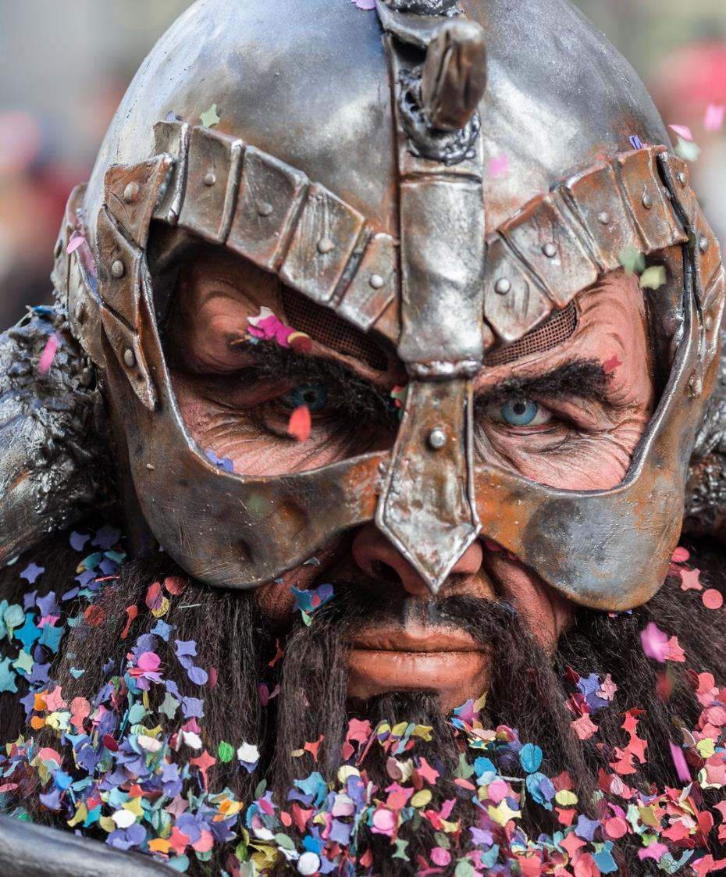
MODULE 4 EXERCISE 2: GUERILLA MARKETING LEARNING ACTIVITY
Did the brand benefit?
How might you use something similar to promote your pop culture tourism business and/or future opportunities?
What events or campaign could you run to promote your pop culture tourism experience, destination or region?

Slide 39
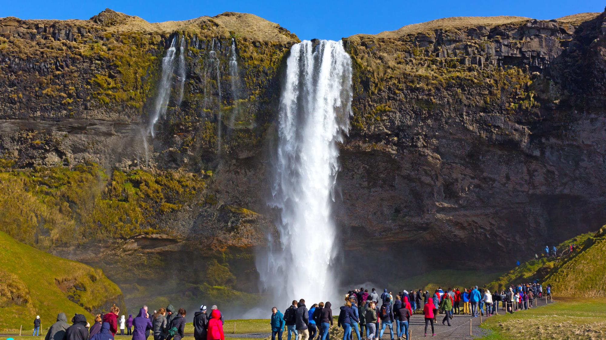
UP NEXT: Module 5 Addressing Some Key Challenges
(As we have been learning Pop Culture Tourism brings many opportunities but there are challenges too. Join us in Module 5 to find out)

Slide 40
Key Sources and Resources in Module 4
www.facebook.com/outpaceeu
www.popculturetourism.eu
Motivations of Sport Fans - Fans and Fan Cultures: Tourism, Consumerism and Social Media (ebrary.net)
Fandom | Fanonia SpongeBobia | Fandom

