Slide 1
Addressing Some Key Challenges
Module 5

Slide 2
MODULE 5 CONTENTS
COVID19 IMPACT AND FUTURE TOURISM
1
MAKING POP CULTURE TOURISM REGENERATIVE AND SUSTAINABLE
2
3
POP CULTURE OVERTOURISM – THE BIEBER EFFECT, THE FROZEN EFFECT AND MORE
SPOTLIGHT ON ECOTOURISM
4
5
COMMERCIALISING VIRTUAL TOURISM EXPERIENCES
This project has been funded with support from the European Commission. This publication reflects the views only of the author(s), and the Commission cannot be held responsible for any use, which may be made of the information contained therein.

Slide 3
SECTION 1
COVID 19 AND TOURISM
In this section we explore the potential impact COVID19 will have on future tourism and today‘s challenges to the tourism landscape in general.

Slide 4
The Tourism Industry has been decimated by COVID19
The Tourism Industry landscape has drastically changed in recent years and the sector longs for a return to “normal” post-Covid times. But experts believe we won‘t see the levels of travel that we had in 2019 until possibly 2029. This great tourism “reset” offers businesses time to rethink, become sustainable and explore new ways to market and promote tourism destinations and recreation

Slide 5
Pop Culture Tourism offers a solution but it comes with its own challenges..
Due to it‘s nature, pop culture tourism can bring its own challenges.
Destinations can become tourism hotspots over night as a result of pop culture and this sudden increased visibility has often led to over tourism and numbers of tourists arriving that destinations, tourism stakeholders and businesses are simply not ready for.
What’s more – pop culture tourism can be very to plan for and predict as it’s so difficult to predict what will capture people‘s attention. On top of this, there are can be legal issues to contend with in promoting a pop culture themed business such as issues surrounding copyright. So, what is and isn‘t allowed? Copyright vs trademark? Where to seek advice?
We’ll try to answer some of these questions for you later in this module..

Slide 6
“
It is too early to say what the long-term implications of the crisis are for tourism, but it is clear that the longer the crisis continues…the more challenging it will be to rebuild the tourism economy. This brings challenges for the sector, but also opportunities to encourage innovation, drive new business models, explore new niches/markets, and open up new destinations.
“
- OECD Policy Responses to Coronavirus (Covid-19)

Slide 7
Potential Post-Covid Tourism Industry implications
Domestic and short haul travel may become more prevailant, due to greater focus on sustainability. Decline in tourism consumption due to ongoing uncertainty.
Longer stays rather than taking many short trips
Regional, coastal and rural areas rather than city destinations.
Safety and hygiene key factors when choosing destinations
Increase in the digitalistaion of tourism services and products.
STAY DURATION
LOCATION
SAFETY
DIGITALISATION

Slide 8
To meet the needs of future tourists, we need to…
Focus on Natural areas
Open and less crowded places
Embed digital and virtual solutions
Ensure our destinations are safe, clean and sustainable

Slide 9
Post-Covid Tourism will be centered on unfollowing the crowds and going off the beaten track.
Pop Culture Tourism can be a key driver…
Ballintoy Harbour in Northern Ireland is one of the many off the beaten track tourism locations visitors and fans of the show now visit..

Slide 10
UNWTO put out guidelines for opening up tourism again in "a safe, seamless and responsible manner."
The guidelines aim to mitigating economic impact, developing safety protocols and coordinated responds, and fostering innovation… priorities 6 and 7 are of particular interest..

Slide 11
UNWTO Priority 6:
Added value jobs through new technologies
UNWTO Priority 7:
Innovation and sustainability as the new normal
UNWTO-Global-Guidelines-to-Restart-Tourism.pdf

Slide 12
In summary - COVID 19 AND TOURISM
The post-Covid world is and will be very different and we will need creative and critical thinking to adapt to a new world. Tourism has all the potential to be a positive force moving forward.
It‘s important for you to see and understand the regenerative, sustainable and pop culture tourism opportunities that exist in your community.
The more we understand our tourism resources, be it culture, nature, history or community, the more opportunities we have for innovative and diverse product development.
Tourism products that are deeply rooted and embedded in the local community have the potential to offer the unique experiences that tourists are always looking for as well as enhancing the local population’s place attachment and pride.

Slide 13
SECTION 2
MAKING POP CULTURE TOURISM REGENERATIVE AND SUSTAINABLE
In this section we will explore the regenerative and sustainable tourism and steps to apply the principles behind them to pop culture tourism

Slide 14
What is Regenerative Tourism?
“Regenerative tourism is not anti-growth; it simply asks that we grow the things that matter most to us in ways that benefit the entire system and never at the expense of others.” (Anna Pollock, 2019). Pop Culture Tourism
Notes:
https://thetourismcolab.com.au/change/23-actions-for-regenerative-tourism/
https://www.earth-changers.com/blog/2020/9/22/regenerative-tourism-what-is-it-and-what-is-it-not
https://www.traveltotomorrow.be/future-vision/

Slide 15
How does Regenerative Tourism work?
It’s about creating value not volume and finding a balance between the supply-side needs and what the demand-side wants.
Regenerative tourisms works for both for the visitors and the destinations. It explores how tourism can contribute to the destination.
Notes:
https://thetourismcolab.com.au/change/23-actions-for-regenerative-tourism/
https://www.earth-changers.com/blog/2020/9/22/regenerative-tourism-what-is-it-and-what-is-it-not
https://www.traveltotomorrow.be/future-vision/

Slide 16
Visit Flanders and the Flemish government have made regenerative tourism the focus of their tourism policy.
www.traveltotomorrow.be

Slide 17
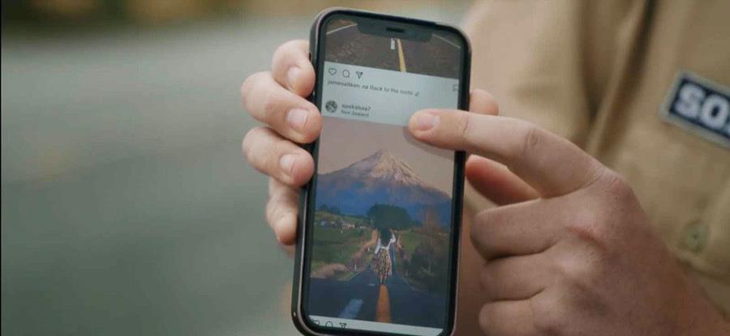
A tongue-in-cheek campaign has been launched in New Zealand to stop people from sharing the same old scenes taken at tourism hotspots. New Zealand’s tourism industry is now urging people to stop “traveling under the social influence,” and to think outside of the box on their next trip!
Notes:
New Zealand Urges Visitors To Stop 'Traveling Under The Social Influence' | Celeb Baby Laundry

Slide 18
Regenerative and Sustainable Pop Culture Tourism
Regenerative tourism is designed in a way that builds capital and ‘gives back’ to the land and people. It is an interesting approach to examine in tandem with Pop Culture Tourism which can sometimes result in the exploitation of a destination as a result of over-tourism for example… So, let’s explore Regenerative Tourism a little more and what it might look like when paired up with Pop Culture Tourism..

Slide 19
When Regenerative and Pop Culture Tourism are combined they have the potential to revitalize unknown parts of a destination but for this to happen more emphasis needs to be put on destinations off the beaten track.
BUT! A recent case study in Barcelona found far from contributing to distributing tourist flows throughout the city, film fiction actually, concentrated visitors at the main attractions of the city!!

Slide 20
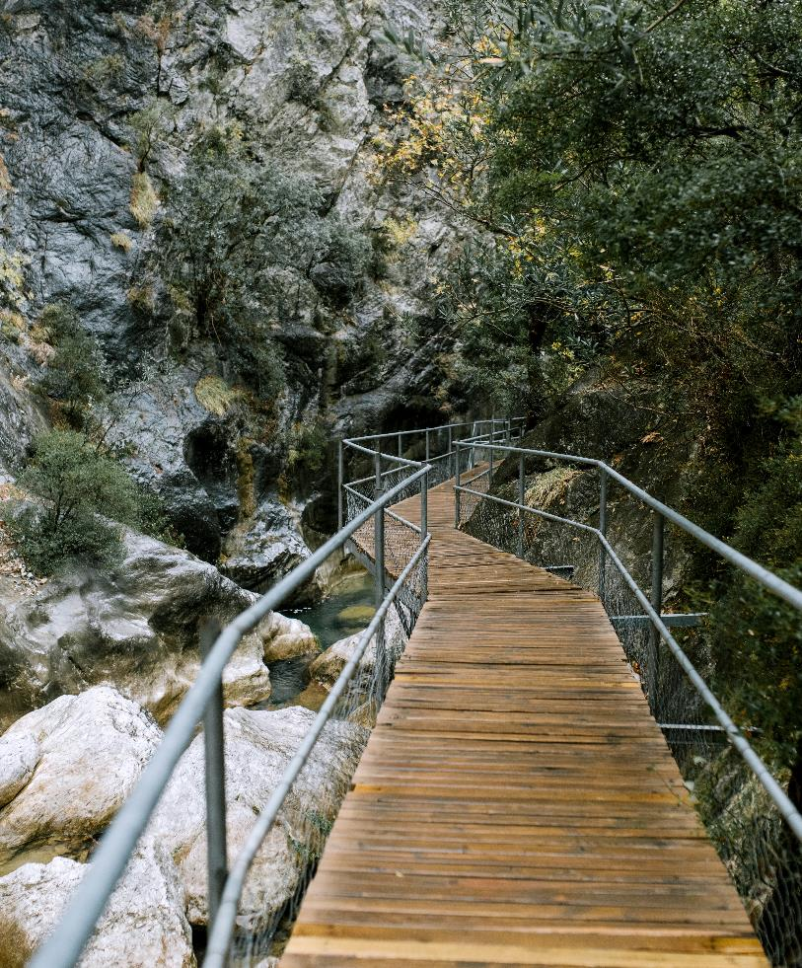
Steps to embed Regeneration into your Pop Culture Tourism Business or Offering
1
Take time to think about what your business can do for the environment. This includes protecting the natural resources around you and also taking steps to reduce waste, recycle, and take environmental factors into account when purchasing supplies and planning your tourism experiences.

Slide 21
Steps to embed Regeneration into your Pop Culture Tourism Business or Offering
Find ways you can contribute to the protection and restoration of ecosystems and reduce your business‘ carbon footprints
2

Slide 22
Steps to embed Regeneration into your Pop Culture Tourism Business or Offering
Identify what your values and purpose is with your business. The benefits of having clear mission statemens are that it often leads to a more engaged customer base.
3

Slide 23
Steps to embed Regeneration into your Pop Culture Tourism Business or Offering
Be inspired by your community and use storytelling to your advantage to tell authentic stories to engage with your customers.
4

Slide 24
Steps to embed Regeneration into your Pop Culture Tourism Business or Offering
5
Be creative and unafraid to think differently. Find new solutions and engage the community around you. Tourism overlaps with a variety of different sectors (such as pop culture as we have learned!), so explore these overlaps and how you can use them to your advantage.

Slide 25
Regenerative and Sustainable Pop Culture Tourism – guiding principles...
UNWTO and the OECD has put emphasis on sustainable tourism when starting tourism up again after Covid-19.
Increased focus on local/ regional needs and wants and that of communities/inhabitants
Regenerative/Sustainable/Pop Culture Tourism need to be born from a cooperation between public institutions, the private sector, and the host communities.
The key is to find a better balance in the tourism industry and host communities moving forward.

Slide 26
SECTION 3
OVERTOURISM – THE BIEBER EFFECT, THE FROZEN EFFECT AND MORE
In this section we will explore the emphasised the need for regenerative tourism and new innovations in the sector.

Slide 27
What is OverTourism?
When certain places attract excessive numbers of tourists it can cause lead to undesirable effects...
Without proper management or oversight, excessive number of tourists can cause strain on infrastructures, nature and inhabitants/communities.
However, the phrase overtourism is often critisised and it is argued that rather than the tourist numbers being the issue, it is more a matter of management, controling the flow of people and making sure the right infrastructures are in place to deal with the numbers of visitors.

Slide 28
The Bieber effect in Iceland
In 2015, Justin Bieber released a music video to the song I‘ll Show You in November which was shot in South Iceland.
The video showed Bieber running around many of South Iceland‘s well known attractions such as the waterfalls Seljalandsfoss and Skógarfoss, and the glacier lagoon Jökulsárlón.
However, his music video also showed two relatively unkown places:
The beautiful canyon Fjarðarárgljúfur
The old plane wreck at Sólheimasandur
Both places saw a drastic increase in visitations after the release.
Notes:
Slideshow of the day: The Bieber effect or plain selfishness? Visitors destroying Fjaðrárgljúfur | Icelandmag

Slide 29
Fjaðrárgljúfur canyon in South East Iceland is one of the most beautiful spots along the entire south coast of Iceland. The walking path along the canyon provides magnificent views of the steep cliffs.
Visits to Fjarðarárgljúfur canyon increased by 87% between 2016 and 2017, and remains a popular destination for tourists today.
Notes:
Slideshow of the day: The Bieber effect or plain selfishness? Visitors destroying Fjaðrárgljúfur | Icelandmag

Slide 30
While the initial increase in tourists visiting the site has been attributed to Bieber‘s video, its popularity was compounded by Instagram and Game of Thrones.
In 2018 and 2019, the canyon was closed down between March and June to allow the delicate vegetation to recover from the environmental damage the increased number of visitors causes.
Notes:
Slideshow of the day: The Bieber effect or plain selfishness? Visitors destroying Fjaðrárgljúfur | Icelandmag

Slide 31
The FROZEN effect – Halstatt Austria
Disney‘s Frozen has brought much attention to places believed to be the inspiration for the kingdom of Arendelle.
Such as Hallstatt in Austria
Hallstatt is a World Heritage site since 1997
It has 780 inhabitants but got 10,000 visitors a day in 2019!!
This has put a huge strain on the community and the city has struggled to find a way to control the number of visitors.

Slide 32
The FROZEN effect – Norway
Disney‘s Frozen has brought also led to a spike in visitors to the west coast of Norway, especially during the summer.
Fjord Norway now wants to spread the visitors more evenly throughout the year, creates year-round jobs and make it more sustainable.

Slide 33
Star Wars Effect – Skellig Michael
The appearance of Skellig Michael and Little Skellig (Kerry, Ireland) in the Star Wars universe has, understandably lead to a huge surge in Star Wars-related film tourism to the area.
Despite rising tourist numbers, the island is thriving. Increased visitor numbers to Skellig Michael over the past six years have caused “no measurable permanent material damage”, according to a new draft management plan for the island.

Slide 34
Star Wars Effect – Skellig Michael
Skellig Michael is a Unesco world heritage site and the protection of the island including tourist flows are managed via a 10-year blueprint.
The Skellig Michael visitor season is from mid-May to September period with a current daily limit of 180 visitors on licensed ferries.
Private vessels are not permitted to land tourists on the island.
The plan also recommends a 1km exclusion zone for drones because Skellig Michael is a nature reserve and an internationally important seabird-breeding habitat.

Slide 35
In summary - OVERTOURISM
Pop Culture can result in a sudden and often unexpected destination becoming popular almost over night and this can lead to overwhelming number of visitors arriving.
User Generated Content on Instagram can add fuel to this making the destination even more viral and popular
Sometimes officials and the tourism industry have to be reactive to the situation instead of proactive.
Tourists interests create new attractions that needs to be followed up on by the tourism industry, new infrastructures and site-management.
Different solutions are being implemented to combat this:
Try to control the flow of visitors or limit the number of visitors allowed per day or try to distribute the visitation through the year.
Building and increasing the infrastructures around the place of interest.
Temporarily (or permanently) closing the places to visitors.

Slide 36
SECTION 4
SPOTLIGHT ON ECO TOURISM
In this section
This Photo by Unknown Author is licensed under CC BY-NC-ND

Slide 37
What is Eco Tourism?
“Ecotourism is catering for tourists in the natural environment without damaging it or disturbing habitats”

Slide 38
Eco Tourism and Pop Culture Tourism
Increased visibility through social media and pop culture can bring issues to certain destinations, especially those with delicate nature or ecosystems.
Therefore it is important to find ways to mitigate those effects, for example by finding ways to make visitors aware of their impact and educating them about the places they are visiting.
Notes:
https://www.rcinet.ca/eye-on-the-arctic-special-reports/arctic-tourism/?fbclid=IwAR3REM8QMrceViS_c1qvNon8LKmJibgXRQxM1i4cSNyQADbDrwt-opwbyPs

Slide 39
Glamping is the perfect holiday solution for many eco-tourists. A well-considered site will be small scale and cause a minimal amount of environmental disturbance with accommodation sympathetic to the local surroundings.
Inspired by the magical land of “The Lord of the Rings”, Hobbit Houses have become a dream destination for both Tolkien fans and not.

Slide 40
“
Inishbofin is an amazing place and so are the people. When we started working together, they looked at everything, not just tourism, but community, conservation and a nature plan. It’s the only island in Ireland to date where the local people and businesses have come together to protect the island’s precious environment and create a community-led ecotourism initiative. Their aim is to develop a tourism product that is sustainable and benefits locals and visitors alike.
“
- Mary Mulvey, head of EcoTourism Ireland

Slide 41
Principles of Ecotourism
Ecotourism is about uniting conservation, communities, and sustainable travel. This means that those who implement, participate in and market ecotourism activities should adopt the following ecotourism principles:
Minimize physical, social, behavioral, and psychological impacts.
Build environmental and cultural awareness and respect.
Provide positive experiences for both visitors and hosts.
Provide direct financial benefits for conservation.
Generate financial benefits for both local people and private industry.
Deliver memorable interpretative experiences to visitors.
Design, construct and operate low-impact facilities.
Recognize the rights of local people and work in partnership with them to create empowerment.

Slide 42
SECTION 5
COMMERCIALISING VIRTUAL TOURISM EXPERIENCES
In this section
This Photo by Unknown Author is licensed under CC BY-NC-ND

Slide 43
Finding new ways to engage with and explore the world
In the aftermath of COVID and in response to Industy 4.0, many companies, both within the tourism industry and outside, have seen opportunities in providing alternative methods of travel.
Virtual Tourism Experiences can provide a new revenue stream, are relatively easy to distribute and are a great tool for engaging new and alternative customers.

Slide 44
Online Guided Tours have been on the rise in 2020. A guide brings the viewers at home along on a journey through a city, region or a country, either pre-recorded or live.
Live tours can take place over Zoom, Google Hangouts or YouTube or other similar online tools. The upside of live tours is that they offer opportunities for interactions between the guide and the customers.
However, tours need to be modified for this new medium, as shorter attention spans and other competing distractions needs to be taken into account.

Slide 45
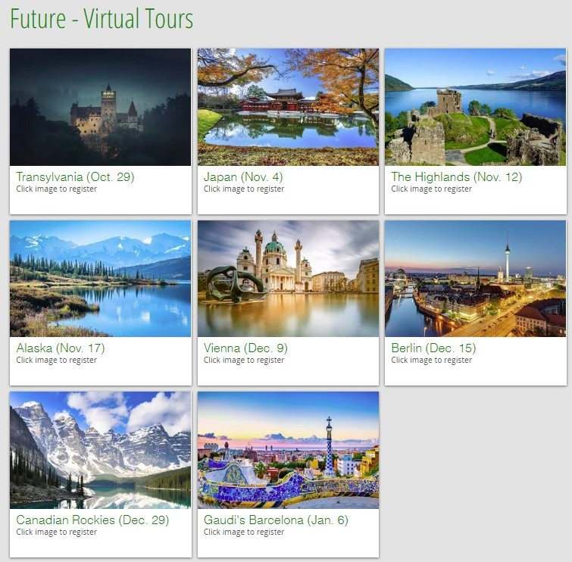
Girl Travel - Virtual Tours
Offering virtual tours, their events have blown up on Facebook for winter 2020-21.
Free but tipping the tour guide is encouraged.
The virtual tours take place on Facebook & Zoom, where tour guides tell viewers about a variety of topics, countries or regions.
For Halloween 2020, a virtual tour centering around the myths and legends of Transylvania, Romania was held.
Live streams available afterwards. The Hallowen stream has been viewed over 100k times on Facebook.
Notes:
www.girltraveltours.com/virtual-tours
Their virtual tours have blown up this fall – their first virtual tours this spring and summer drew a few hundred people to them. Now tens of thousands are tuning in.

Slide 46
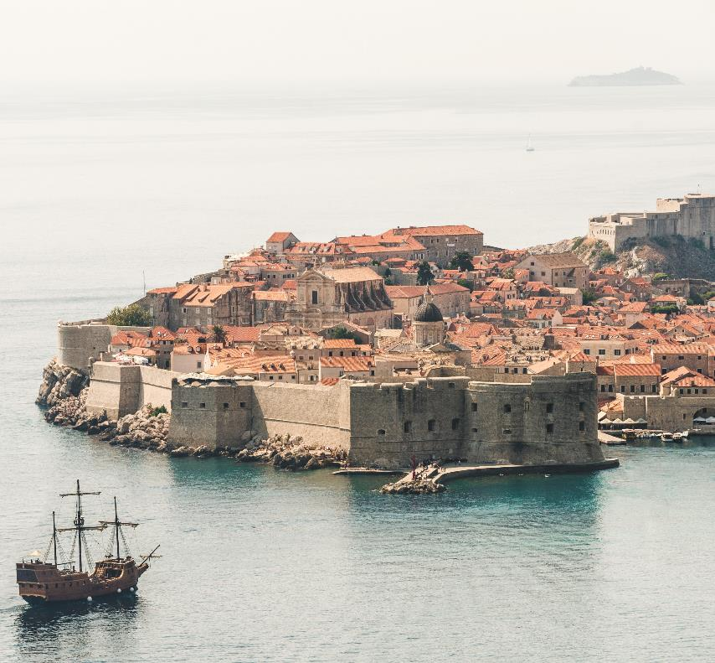
LIVE Old town Dubrovnik walking tour
1 hour tour through Dubrovnik via live cam, offered through Tours by Locals.
The walking tour covers the history of the city, architecture, hidden gems, and Game of Thrones locations.
Many reviewers say the tour made them want to visit the city in-preson in the future.
- Live tours can be investments in future customers.
The guide Michael was very knowledgeable and passionate about his city and gave us an interesting tour that inspired us to visit Dubrovnik in the future.
- Review of the tour taken from the tour’s website, female reviewer from Australia

Slide 47
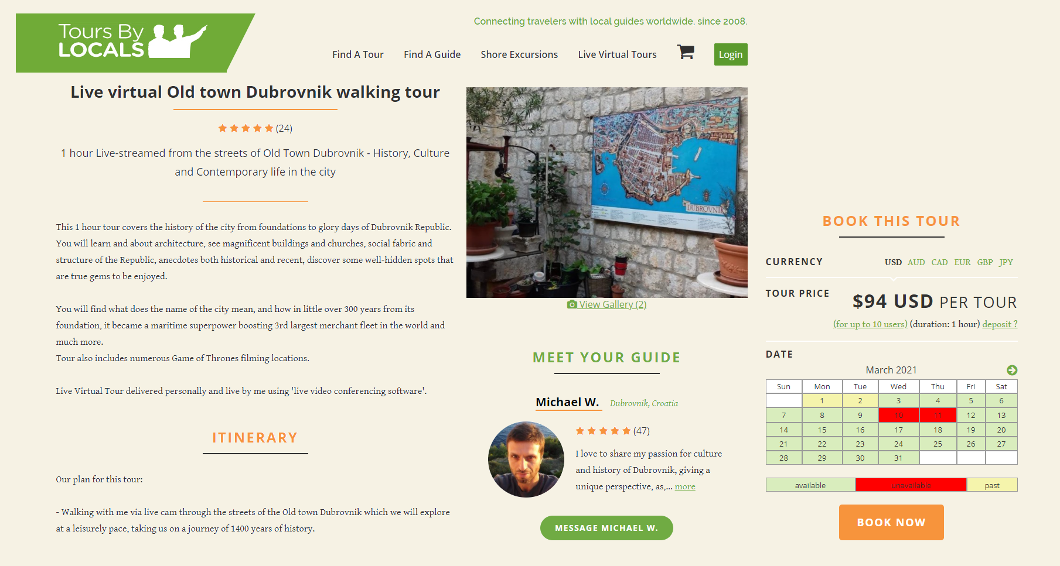
Virtual Tours are example of how technology can be used to an additional revenue stream for tourism operators

Slide 48
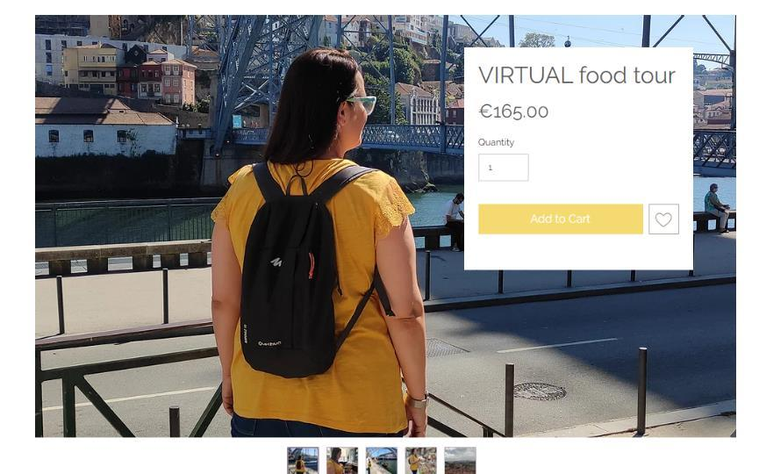
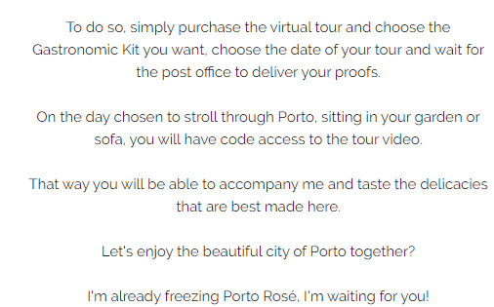
For semi-immersive tours, the customers get something physical delivered to them in preparation for the tour. For example, food, beer or wine. This is then accompanied by a live or pre-recorded tour with a tour guide.
https://en.homemadefoodandfun.com

Slide 49
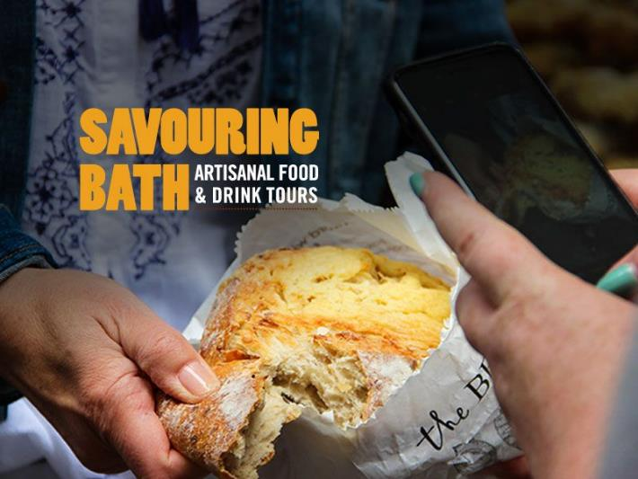
Virtual tour of Bath‘s culinary heritage
Adaption of a “regular” tour Savouring Bath have offered, where the city‘s food history and heritage is the main focus.
Online tour, Food Heroes offered with and without a sample box.
“It is a unique way to enjoy Bath’s culinary scene without being present in the city, either to prepare for a visit, or just as a fun way to learn more about this curious part of the city’s heritage.” - From the tour’s description on Savouringbath.com
Live virutal tour offered visitors/ customer‘s a chance to interact with the tour guides and ask them questions.
Notes:
https://savouringbath.com/tours/virtual-food-heroes/

Slide 50
Immersive Tours and Virtual Reality
Virtual Reality (VR) has seen a big growth in travel categories, espcecialy during the Covid-19 crisis. Many destinations, tourism boards, and museusm have been using VR-technology to keep potential visitors interested. VR-developers and various companies have joined forces to create content within this field. 3D experiences are created with 360 cameras or other digital mediums.
Notes:
https://www.bbc.com/news/business-54658147

Slide 51
Discover Frankfurt‘s new old town
The DomRömer Quarter was opened in 2018.
Quickly became one of the most popular tourist destinations in Frankfurt, with over 8000 visitors a day.
A virtual tour of the new old town is now available: https://www.deutschland.de/en/topic/culture/frankfurt-has-a-new-old-town-360deg-tour

Slide 52
National Geographic Explore | Oculus Quest
With National Geographic Explore, Oculus Quest visitors set off as a NatGeo photographer on an expedition to Machu Picchu to discover the Inca citadel, witness mummy worship, and even raise a cup of sacred chicha. And on an epic second mission they explore Antartica.
Take a look here: National Geographic Explore VR on Oculus Quest | Oculus
National Geographic Explore | Oculus Quest - YouTube

Slide 53
Livestream Festivals
Various festivals, like music and film festivals, have also had to find new ways to bring the festivals to their customers.
A way to continue the relationship with their customer base and maintain their visibility on the music scene and keep brand loyal pop culture tourists engaged.

Slide 54
The annual Icelandic music festival Iceland Airwaves is held annually in November in Reykjavík. The festival usually draws thousands of international visitors ot the capital city each year. In 2020, due to Covid-19 restrictions, the festival was moved online under the title „Live from Reykjavík“.

Slide 55
In summary – VIRTUAL TOURISM OPPORTUNITIES
Using virtual reality in any form can be a great way to reach new customers or potential-visitors where they are right now.
Can provide a new revenue stream while other operations are closed down.
Virtual reality is a relatively new platform but has great potential for the tourism industry in the future and in particular Pop Culture Tourism, given that it is an extension of the gaming industry!

Slide 56
MODULE 5 EXERCISE 1: TOURISM IN THE FUTURE EXERCISE
Consider the Covid-19 secure precautions that you have had to build into your operations this year. Consider how these might be adapted for the future making the most of best practice. Make a list of all the measures which have had to be introduced to ensure social distancing and provide a Covid-19 secure environment. Then evaluate their impact on normal operations. Have they proved to be too restricting, or are there any features you would keep when the threat of Covid-19 has receded sufficiently to no longer warrant them for their original purpose.

Slide 57
For example, some institutions report an increase in visitor satisfaction from having introduced bookable, timed entry tickets to eliminate queuing. Others have introduced virtual or self-guided tours. There are many other examples which you may consider. Complete this table:
List the Covid-19 safety measure introduced | Advantages | Disadvantages | Keep or not? Why/not?

Slide 58
MODULE 5 EXERCISE 2: VIRTUAL TOURISM EXPERIENCES
Covid-19 and the need for social distancing has led to the development of a variety of new virtual experiences for tourists. Think of the ways in which you could turn your offering into a commercial virtual experience. - What would you include? - How could you make your experience stand out? -What could you charge for this experience?
Research other examples of similar experiences and their cost to help you to consider the set up cost and the value of such experiences to the consumer.

Slide 59
UP NEXT: Module 6 POP CULTURE TOURISM STRATEGIC PLANNING AND SUSTAINABILITY
(Our final module in this series)

Slide 60
Key Sources and Resources in Module 5
www.facebook.com/outpaceeu
www.popculturetourism.eu
UNWTO-Global-Guidelines-to-Restart-Tourism.pdf
https://thetourismcolab.com.au/change/23-actions-for-regenerative-tourism/
Slideshow of the day: The Bieber effect or plain selfishness? Visitors destroying Fjaðrárgljúfur | Icelandmag

