Slide 1
Sustaining Pop Culture Tourism Experiences and Projects
Module 6

Slide 2
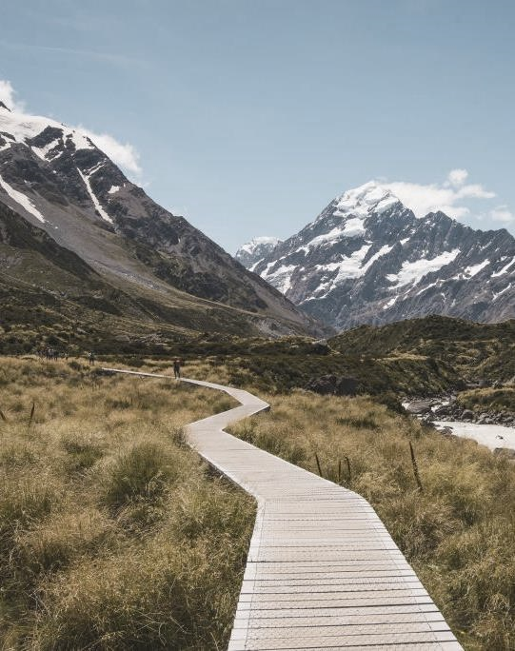
MODULE 6 CONTENTS
SUSTAINING POP CULTURE TOURISM - AN OVERVIEW
1
LASTING GROWTH OF YOUR POP CULTURE TOURISM BUSINESS
2
3
BENEFITS OF BEING PART OF A STRONG REGIONAL AND SUSTAINABLE POP CULTURE TOURISM BRAND/PROMOTION
SPOTLIGHT ON COMMUNITY TOURISM
4
PREPARING FOR FUTURE POP CULTURE TOURISM OPPORTUNITIES
5
This project has been funded with support from the European Commission. This publication reflects the views only of the author(s), and the Commission cannot be held responsible for any use, which may be made of the information contained therein.

Slide 3
SECTION 1
SUSTAINING POP CULTURE TOURISM
- AN OVERVIEW

Slide 4
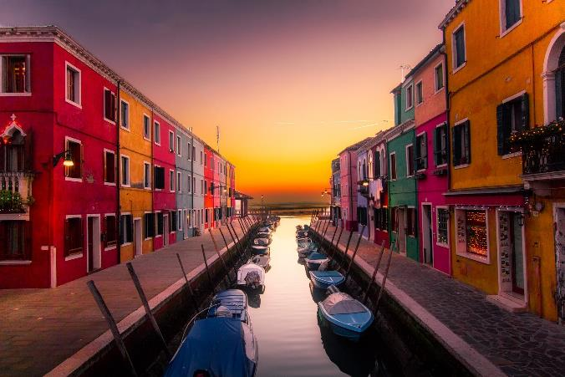
SUSTAINING POP CULTURE TOURISM
To ensure the benefits of pop culture tourism are sustained and long lasting in our regions, we must take full account of its current and future economic, social and environmental impacts, addressing the needs of visitors, the industry, the environment and host communities.
For this reason the OUTPACE project promotes not only pop culture tourism business development and innovation but also a wider regional outlook and development approach. You can access and view regional development supports on www.popculturetourism.eu

Slide 5
SUSTAINABLE TOURISM AND THE 2030 GLOBAL AGENDA
The World Tourism Organization defines sustainable tourism as “tourism that takes full account of its current and future economic, social and environmental impacts, addressing the needs of visitors, the industry, the environment and host communities".
Sustainable tourism is addressed in the 2030 SDG’s which say that:
By 2030, we need to devise and implement policies to promote sustainable tourism that creates jobs and promotes local culture and products (8.9). Pop culture tourism can do that BUT…….
Pop culture tourism MUST be part of the effort to support sustainable tourism activities and relevant capacity-building that promote environmental awareness, conserve and protect the environment, respect wildlife, flora, biodiversity, ecosystems and cultural diversity, and improve the welfare and livelihoods of local communities by supporting their local economies and the human and natural environment as a whole.
Source

Slide 6
Now is the time to embrace a sustainable new business focus
Many tourism businesses reinvented themselves in order to survive and weather the COVID19 pandemic which decimated the world tourism economy. In the context of a reset and building back better, crisis provides an opportunity to rethink and change how tourism interacts with our regional communities, our environments, and our cultures can act as a leader/exemplar in sustainable change to set again or differently. It is time for pop culture tourism to come to the fore in this rethink/reset.

Slide 7
SECTION 2: LASTING GROWTH OF YOUR POP CULTURE TOURISM BUSINESS

Slide 8
LASTING GROWTH OF YOUR POP CULTURE TOURISM BUSINESS
We’ve been learning about the opportunities pop culture tourism can bring your business and region but we have also learned of the potential challenges of a destination becoming an overnight success. That is why we are keen to help you embed sustainability and lasting growth into your business..

Slide 9
LASTING GROWTH–EMBRACE SUSTAINABILITY AS ONE OF YOUR BELIEFS
1
Tourists are demanding socially and environmentally-savvy products and experiences without compromise like never before. Building sustainability into your pop culture business briefs from the beginning is a strategic move.
Hobbit inspired eco-friendly tourism lodgings are a great example!

Slide 10
EMBRACE CHANGE, EVEN IF ITS SCARY AND UNKNOWN
2
Embracing change is key to sustaining your business but also business growth. When you change and act fast, you can quickly become a market leader, but if you remain still and don’t change and adapt to the situation, you can face extinction. How can you ensure your pop culture tourism business is not a response to a short-term opportunity but a lasting business model? Embracing change (and especially technology) is key.
In Module 2, we learned about the powe and potential of futuristic VR tourism..

Slide 11
TIMING IS EVERYTHING
3
Time and speed is a key factor in Pop Culture Tourism as we often see destinations become popular over night. Speed is also a factor in sustainability. If you don’t get the timing right, you could potentially lose out on the opportunity to position your business as a market leader
To really capitalise on future pop culture tourism, you need to be ready to launch your business/experience soon or just after the show airs.. This means staying in tune with pop culture opportunities in your region. NB – see our insights on www.popculturetourism.eu

Slide 12
EXCEL IN ONE AREA AND COLLABORATE
4
Tourism development is no longer about one company delivering value to every client at every place; it’s about being a part of an ecosystem. In pop culture tourism there are great collaboration opportunities for accommodation providers, tour guides and activity providers to collaborate and package their offerings rather than compete..
Tourism Northern Ireland is a winner in creating a lasting legacy. The agency has negotiated a licence agreement with HBO recognising Northern Ireland as official Game of Thrones territory.

Slide 13
GAME OF THRONES
JOURNEY OF DOORS PASSPORT
The Doors, created by Tourism NI and Tourism Ireland, were carved from trees blown down in storm in January 2016 at the Dark Hedges in Co Antrim – perhaps the most iconic Game of Thrones filming location in Northern Ireland. Each door depicts moments inspired by Season 6 referencing key scenes and events from the show.
Tourists are invited to visit the Doors across 10 locations in Northern Ireland‬, all places that appeared across all seasons of the show. They get their Journey of Doors Passport stamped at each location – a must-have souvenir for all Thronies. ‬‬‬
Journey of Doors - Discover Northern Ireland

Slide 14
WORK WITH KEY STAKEHOLDERS AND PLANNERS TO RESPONSIBLY MAKE THE MOST OF OPPORTUNITIES
5
Tourism is an excellent way to encourage and provide access to cultural experiences, but it also brings with it challenges related to overcrowding, cultural appropriation and the loss of authenticity. Pop culture tourism brings money and jobs to cities and regions, but it can also damage residents’ day-to-day lives, as well as the area’s culture and heritage. For this reason, it’s important to work with others to not only promote but also protect tourism assets in your region..

Slide 15
SUSTAINABLE POP CULTURE TOURISM – SKELLIG MICHAEL, IRELAND
In Kerry, Ireland, stakeholders are working to capilitalise on Skellig Michaels STAR WARS fame. Access to the Skellig island is only via one of the 15 licensed Skellig Michael Landing Tour boats that are granted a landing tour license by the OPW.
These boats carry 12 passengers each, meaning only 180 people are allowed to land on the island daily. Skellig Michael was inscribed on the World Heritage List in 1996 - Sceilg Mhichíl - UNESCO World Heritage Centre

Slide 16
TAKING OVERTOURISM ACTION IN DUBROVNIK
For Dubrovnik, doubling as King’s Landing in Game of Thrones is a mixed blessing. Stardom has been a boon for business – but has also sparked an inundation of visitors to a city already struggling with overcrowding.
In 2018, the Mayor of Dubrovnik took action and shut 80% of the souvenir stalls clogging up the city centre and imposed a quota on bus and cruise tourists. This was a key action to combat overtourism and embed more sustainable planning for the future.
Source

Slide 17
SECTION 3: BENEFITS OF BEING PART OF A STRONG REGIONAL AND SUSTAINABE POP CULTURE TOURISM PROMOTION

Slide 18
POWER OF REGIONAL BRANDS AND PROMOTIONS
When overseas visitors start planning their visit, they will tend to connect with regional experience brands first. When you align your offers with your regional experience brand, you make it easier for visitors to make sense of your location and the kinds of experience you will be able to offer. The attention the brand receives can begin to funnel visitors towards your project.

Slide 19
“
Destination Tourism Branding conveys the promise of a memorable travel experience that is uniquely associated with the destination, it also serves to consolidate and reinforce the recollection of pleasurable memories of the destination experience
– Ritchie and Ritchie 1998
“

Slide 20
FOR SOME DESTINATIONS – POP CULTURE BECOMES PART THEIR TOURISM IDENTITY AND DNA..
“The Quiet Man,” John Ford’s 1952 movie starring John Wayne, Maureen O'Hara was set in the village of Cong, Mayo Ireland. Now, with its bronze statue of Mary Kate Danaher and John Thornton, to its Quiet Man Cottage Museum, to its guided tours, the classic movie continues to bring visitors into town, some 70 years later.
CC BY-NC-ND

Slide 21
BENEFITS OF BEING PART OF BUILDING A STRONG REGIONAL TOURISM PROMOTION
A UNIFYING VOICE - CREDIBILITY AND TRUST
OPPORTUNITIES TO COLLABORATE AND LEARN TOGETHER
Marketing your region as a pop culture region and have all tourism businesses unified in voice and message can quickly establish your footing as a must visit destination.
Regional promotion is all about knowledge sharing and a creating a culture of collaboration and co-creation. You can learn a lot by working with your peers.
SUSTAINABLE AND RESPONSIBLE DEVELOPMENT
DRIVE AWARENESS AND SALES
Agreeing on and working towards a united vision or common goals is important particularly when pop culture tourism is concerned. Pop culture can lead to overtourism so this needs to be planned for and managed carefully.
The ultimate goal of a regional/destination promotion is to increase tourist revenue for all and a well executed regional promotion can bring business benefits to many.

Slide 22
DESTINATION PROMOTION
Destination promotion is about developing a unique personality and image differentiating from all competitors.
The first step for any successful destination promotion campaign is to understand how your region is perceived. Destination marketing involves a holistic 360-degree approach to crafting, developing and nurturing a unique identity for the destination.

Slide 23
Destination promotion is driven by three main factors, which represent the fundamentals of a destination brand:
REPUTATION
IDENTITY
PERCEPTION

Slide 24
REPUTATION is the sum of the beliefs or opinions about the destination, it needs to be built, protected, maintained and changed, if needed, over time.

Slide 25
IDENTITY has to be driven by authenticity, unique selling points of the destination, consistency and strong personality.

Slide 26
PERCEPTION is mostly made of immaterial experiences, even though material experiences matter as well, and it is subjective, in the mind of consumers.
Now that we know this, let’s take a look at how some regions/destinations are promoting themselves as pop culture tourism destinations..

Slide 27
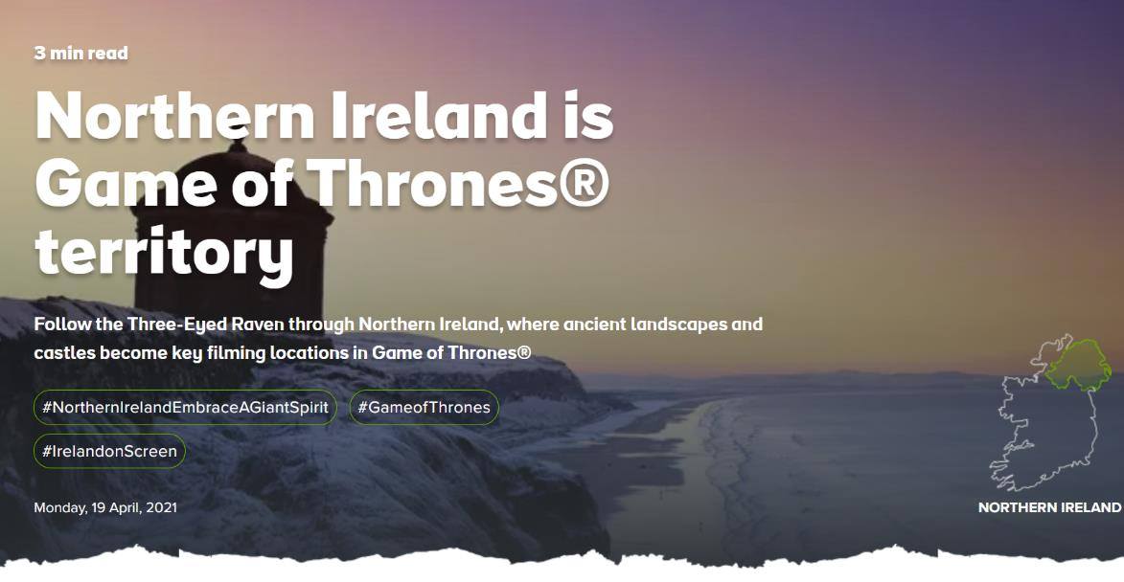
NORTHERN IRELAND IS OFFICIAL GAME OF THRONES TERRITORY
In 2019, Tourism Ireland negotiated a licence agreement with HBO recognising Northern Ireland as official Game of Thrones territory which allows the region to create spin off tourism products.

Slide 28
EDINBURGH SCOTLAND
Edinburgh, Scotland embraces its pop culture links to wizards, dragons, knights, unicorns and spellbinding stories that never end in this #ForeverEdinburgh destination marketing campaign..
Source

Slide 29
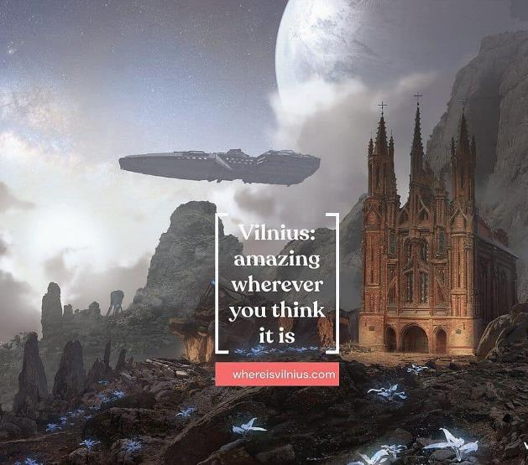
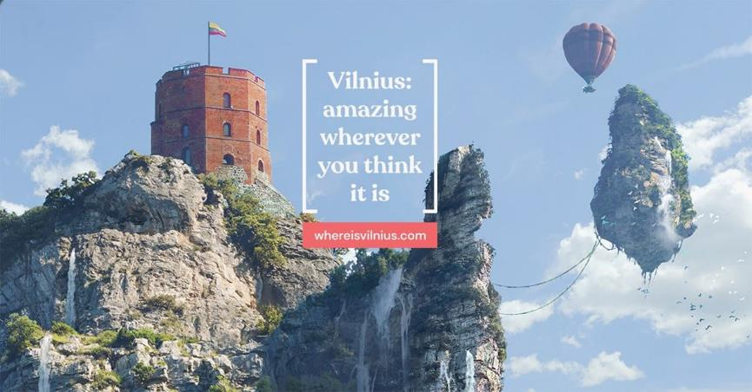
VILNIUS, LITHUANIA – POSITIONS ITSELF FOR MAKE MOST OF CURRENT AND FUTURE POP CULTURE TOURISM OPPORTUNITIES
The Where is Vilnius campaign presents Vilnius in a imagination and clever way and shows how the city can be “amazing whereever you think it is.”
The campaign tells us that:
“Walking around the city is like taking a stroll through film history.”
Where is Vilnius?

Slide 30
MUSIC TOURISM ROCKS IN SWEDEN
Sweden rocks – literally – around the world, with popular bands of yesteryear ABBA, the Cardigans, Ace of Base and Roxette still big-time popular. The ‘second wave’ of Swedish musical acts like Avicii, Zara Larsson, the Knife and many others are proving that the Swedish music phenomenon is no flash in the pan.
Visit Sweden embraces this
“Do they put something in the water here?
Who knows, who cares? Come to Sweden and see your favourite Swedish act on their home turf.”
Swedish music | Visit Sweden

Slide 31
TOP TIPS:
You can connect your pop culture tourism offer to the regional promotions/brands by:
Telling stories that link to your destination’s themes
Creating meaningful, hands-on and/or immersive experiences that bring those themes to life
Using images and language that match your brand’s tone
Adding brand logos to your website and publicity materials
Getting involved with the brand on social media by sharing material and using things like destination hashtags
Source

Slide 32
SECTION 4: SPOTLIGHT ON COMMUNITY TOURISM

Slide 33
WHAT IS COMMUNITY TOURISM?
Community tourism offers a grassroots and (potentially more) sustainable mechanism to explore pop culture tourism. Community tourism involves local people in the planning, decision making and implementation of tourism activities and involves them in the decision of how to use the project to develop their communities. This empowers local people as they have a say in how development occurs in their area.

Slide 34
COMMUNITY TOURISM IS RELEVANT TO POP CULTURE TOURISM IN THAT IT NEEDS TO:
Be authentic and should reflect the unique attributes of the destination.
Have the support of the host community.
Respect the natural and cultural environments.
Be different from the competitors, avoiding copying developments blindly.
Be of sufficient scale to make a significant economic contribution, but not very large to create high economic leakage.

Slide 35
CREATING VALUE FOR YOUR COMMUNITY
When you give visitors what they value, they repay your community by engaging with and enjoying what you offer. They also spend time and money in and around your project, and this creates knock-on benefits.
Tell visitors about your community-centred vision – share the story about how your project was born and explain how it has progressed through local efforts.
Embrace sustainable principles. Talk about sustainability – tell visitors you are recycling, reducing energy and waste and working to eliminate single-use plastics.
Source local foods – let visitors know you are supporting local farmers and suppliers.
Showcase local arts and crafts – add quality and originality to your product offering.
Involve local craftspeople and artists – attract visitors with demonstrations and workshops and think about hiring local artists to create high-quality visual interpretation and design work to set your pop culture tourism initiative/experience apart.
COMMUNITY VISION
SUSTAINABLE FOCUS
PROMOTE LOCAL PRODUCE
PROMOTE LOCAL TALENT

Slide 36
KEY RESOURCE: COMMUNITY TOURISM TOOLKIT
Community tourism projects can range from one-day festivals to year-round heritage centres and are owned and/or managed by local communities.
This document contains information, practical tips and planning tools that will help you overcome common challenges and make progress towards creating a sustainable tourism enterprise that can support recovery in your locality and beyond.
Access this resource: Community-Tourism-Toolkit.pdf

Slide 37
SECTION 5: PREPARING FOR FUTURE POP CULTURE TOURISM OPPORTUNITIES
This Photo by Unknown Author is licensed under CC BY-SA

Slide 38
PREPARING FOR FUTURE POP CULTURE TOURISM OPPORTUNITIES
In this course, we have presented the vast opportunities and innovation potential that pop culture tourism presents. We have also uncovered some challenges and issues concerning the development of pop culture tourism. Overtourism is one we are repeatedly drawn back to and tends to appear when regions are not prepared for the sudden popularity they often garner overnight due to films, books, celebrities etc. bringing them into focus.

Slide 39
As a key takeaway from this course and final words we offer some insights on to stay ahead of the game and to plan/prepare for future pop culture tourism opportunities which could be just around the corner..

Slide 40
TOP TIPS TO PREPARE FOR FUTURE POP CULTURE TOURISM OPPORTUNITIES
DEVELOP A POP CULTURE TOURISM DEVELOPMENT MINDSET
1
You are already immersed in pop culture – but we encourage you to take a more active and conscious stance in keeping your business current. Be plugged in to emerging developments. Framing your mindset for changes in pop culture themes will prepare you for future business opportunities that can and will present

Slide 41
EXAMPLE
The Fable Bar, UK
Inspired by the fantasy world of fairy tales, the fabulous fables of Aesop and our spellbinding adventures around the globe, The Fable is a bar and restaurant out of the ordinary. Inventive, innovative and enchanting, every detail tells a story, from the sparkling crystal and beautiful blooms, to the twinkling candelabras and the carefully curated collection of storybooks, you're sure to be enthralled.
Source

Slide 42
TOP TIPS TO PREPARE FOR FUTURE POP CULTURE TOURISM OPPORTUNITIES
EXPLORE PAST POP CULTURE TOURISM OPPORTUNITIES LINKED TO YOUR REGION
2
To prepare for future pop culture tourism opportunities, research and review how past opportunities have continued to develop. Have tourism providers created pop culture tourism experiences and tours? Were they successful? Are they still running? How have they evolved? How popular are they? All of this information will help you prepare and plan for future opportunities
This island in Thailand has been named James Bond Island
Source

Slide 43
TOP TIPS TO PREPARE FOR FUTURE POP CULTURE TOURISM OPPORTUNITIES
MONITOR AND ACTIVELY LISTENT FOR FUTURE POP CULTURE OPPORTUNITIES
3
Pop culture tourism opportunities appear regularly and while there is no way to know for sure what will be a hit or not before its consumed. Actively listening and knowing what’s going on locally will put you (and your community/ destination) in a better position to capitalise when the opportunity does arise.

Slide 44
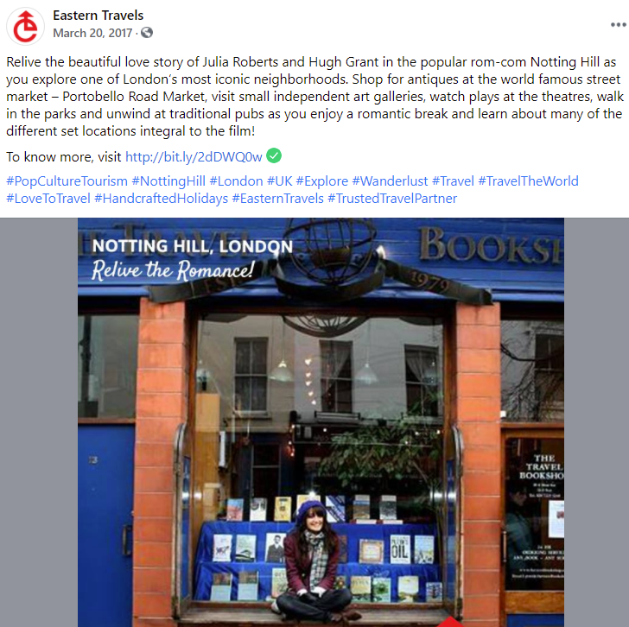
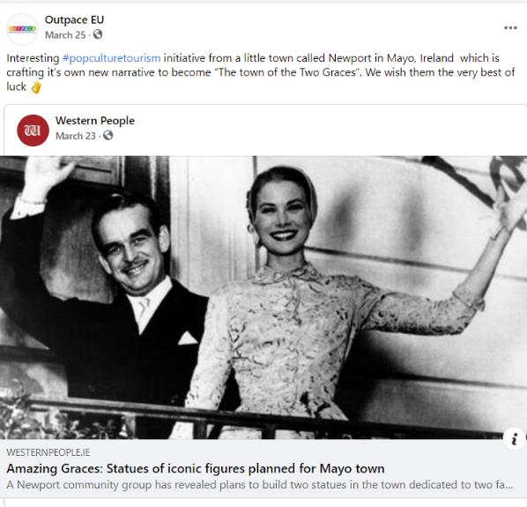
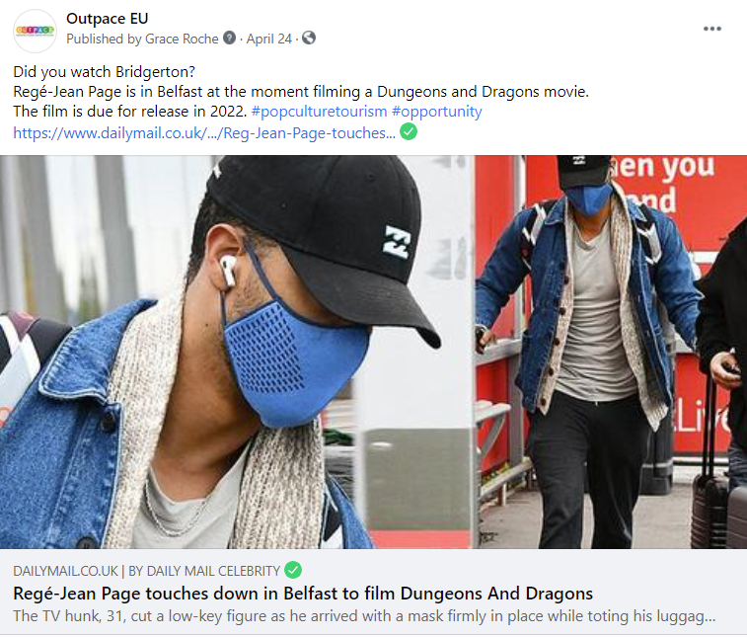
Follow and explore hashtags like #popculturetourism

Slide 45
NETWORK WITH OTHER POP CULTURE TOURISM PROMOTERS
4
Breaking new ground and trying something different brings a host of challenges. Learning from and networking with your pop culture promoter peers and discussing current and future pop culture tourism opportunities is a great way to build your knowledge, skills and confidence to become a pop culture tourism promoter.
You can connect with other like minded and interested pop culture tourism promoters on our OUTPACE facebook page: www.facebook.com/outpaceeu

Slide 46
MODULE 6 EXERCISE 1:
PLANNING A REGIONAL POP CULTURE TOURISM BRAND
Your local Destination Management Organisation (DMO) has asked you to co-ordinate a Pop Culture Tourism steering group in your local area in order to develop a strong regional Pop Culture Tourism brand. Consider the following: - What type of stakeholders would you approach to join this group? - How would you communicate with them? - How would you work together to develop a regional brand?

Slide 47
MODULE 6 EXERCISE 2:
EVALUATING AND IMPROVING
Once it has been launched, it’s important to continue to evaluate and monitor your Pop Culture Tourism product in the future to ensure that it continues to be relevant and appealing. To help you with this important task, create a checklist of activities that you will need to carry out under the headings of short term, medium term and long term in order to keep your offering fresh and viable.
This checklist might include refreshing your web presence, keeping your social media up to date, researching changes in the local pop culture tourism landscape, liaising with local DMO to continue to align your offering to the regional strategy.

Slide 48
UP NEXT: Our OUTPACE course is complete. All that’s left now is for you to put your new POP CULTURE TOURISM knowledge into action and bring pop culture to life in your tourism business. May the force be with you!

Slide 49
Feel you need some more learning resources or support? Visit www.popculturetourism.eu

Slide 50
Key Sources and Resources in Module 6
www.facebook.com/outpaceeu
www.popculturetourism.eu
Sustainable tourism | Department of Economic and Social Affairs (un.org)
https://discovernorthernireland.com/blog/read/2020/06/journey-of-doors-b66
https://failtecdn.azureedge.net/failteireland/Community-Tourism-Toolkit.pdf

